Slide 1


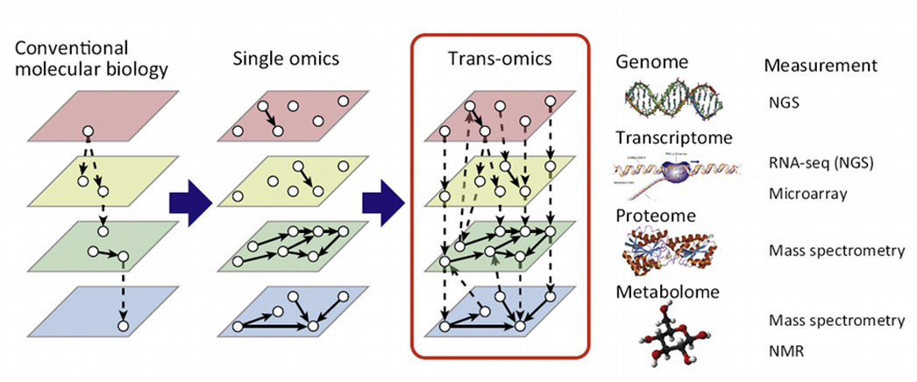



Supervised Machine Learning MultiOmics Integration
Physalia course, 15-17 December 2025, University of Barcelona Nikolay Oskolkov, MRG Group Leader, LIOS, Riga, Latvia
@NikolayOskolkov
@oskolkov.bsky.social
Personal homepage: https://nikolay-oskolkov.com
Image adapted from Yugi et al., Trends Biotechnol. 2016

Slide 2
Brief Introduction to Supervised Machine Learning

Slide 3
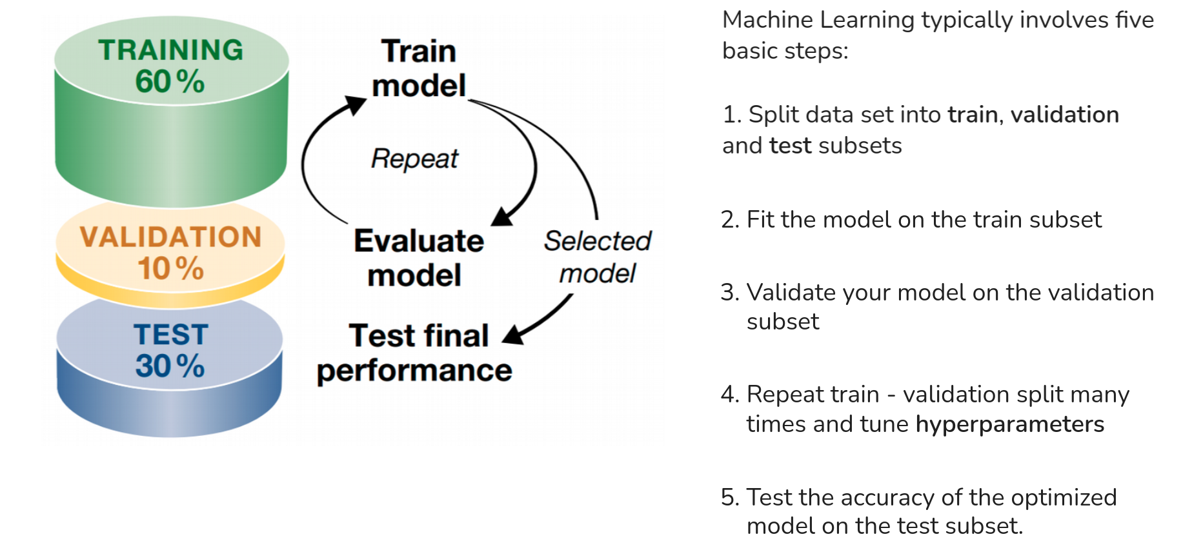
How does Machine Learning work?
Y = f ( X ), where X is input (data) and Y is output (response)
Y is present – supervised machine learning
Y is absent – unsupervised machine learning
Image adapted from Angenmueller et al., Mol. Syst. Biol. 2016

Slide 4
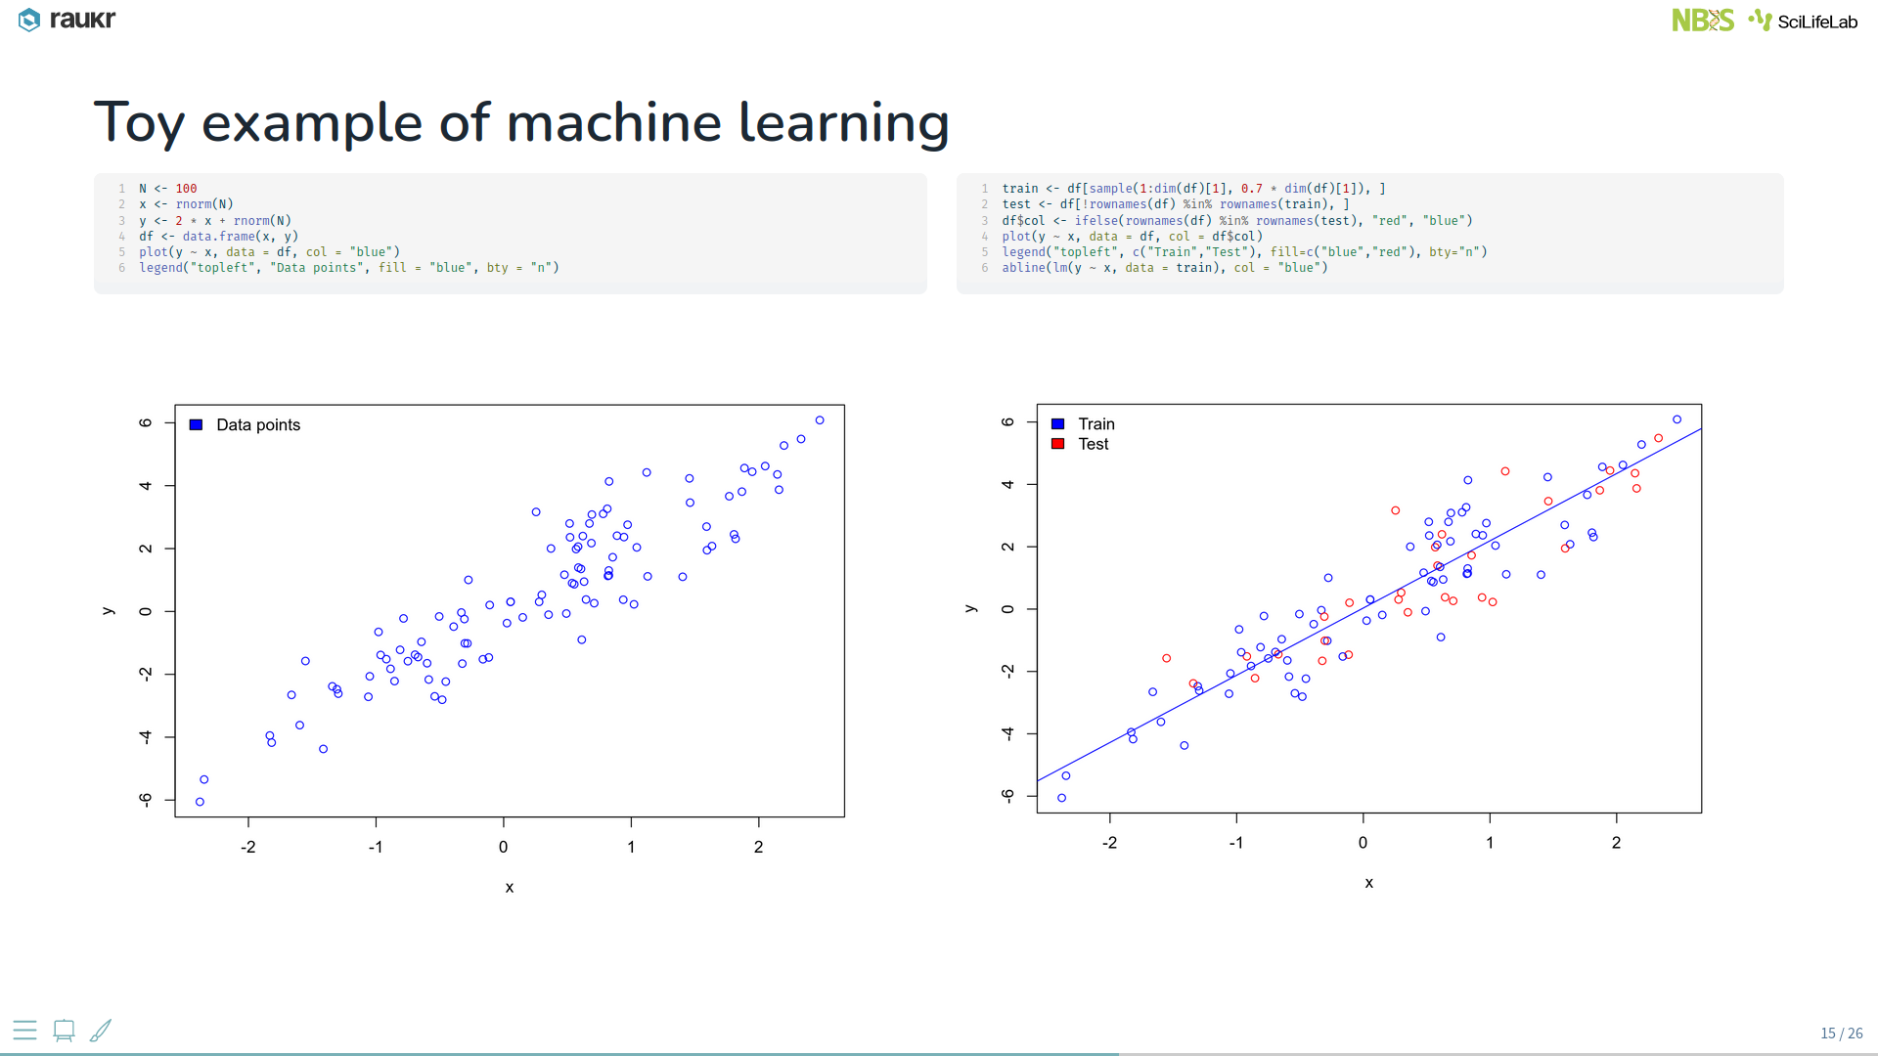
Toy example of supervised machine learning

Slide 5
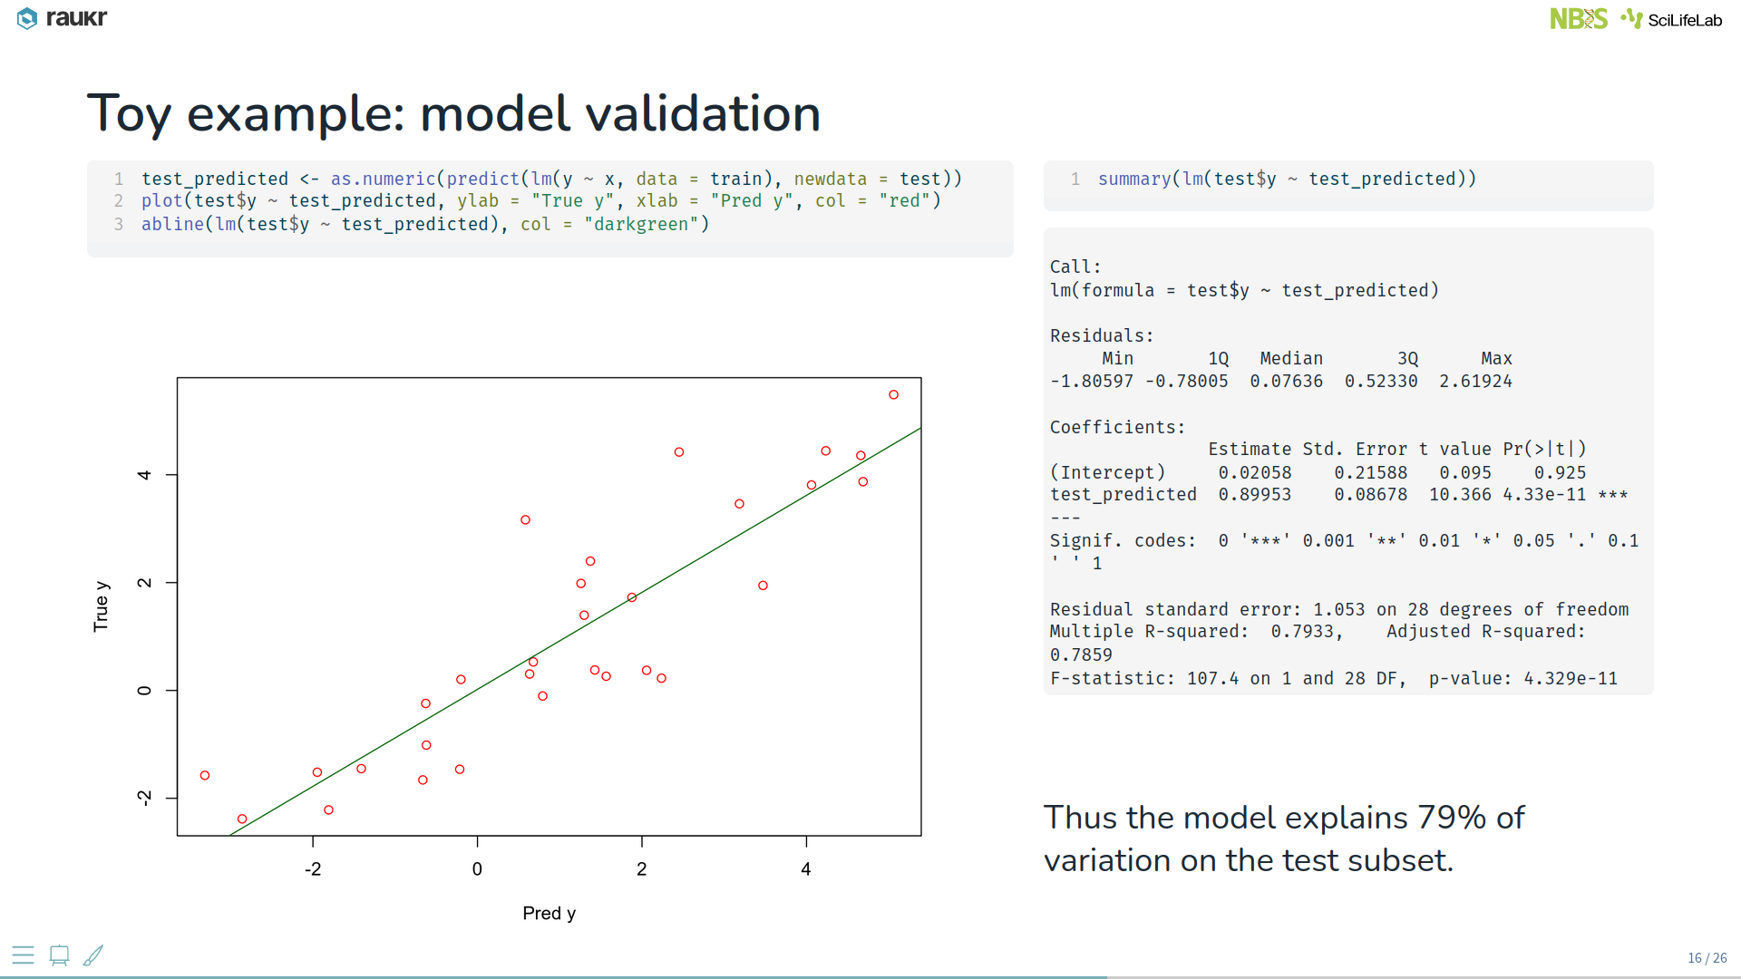
Machine learning model validation

Slide 6
Supervised Machine Learning applied to Omics Integration

Slide 7
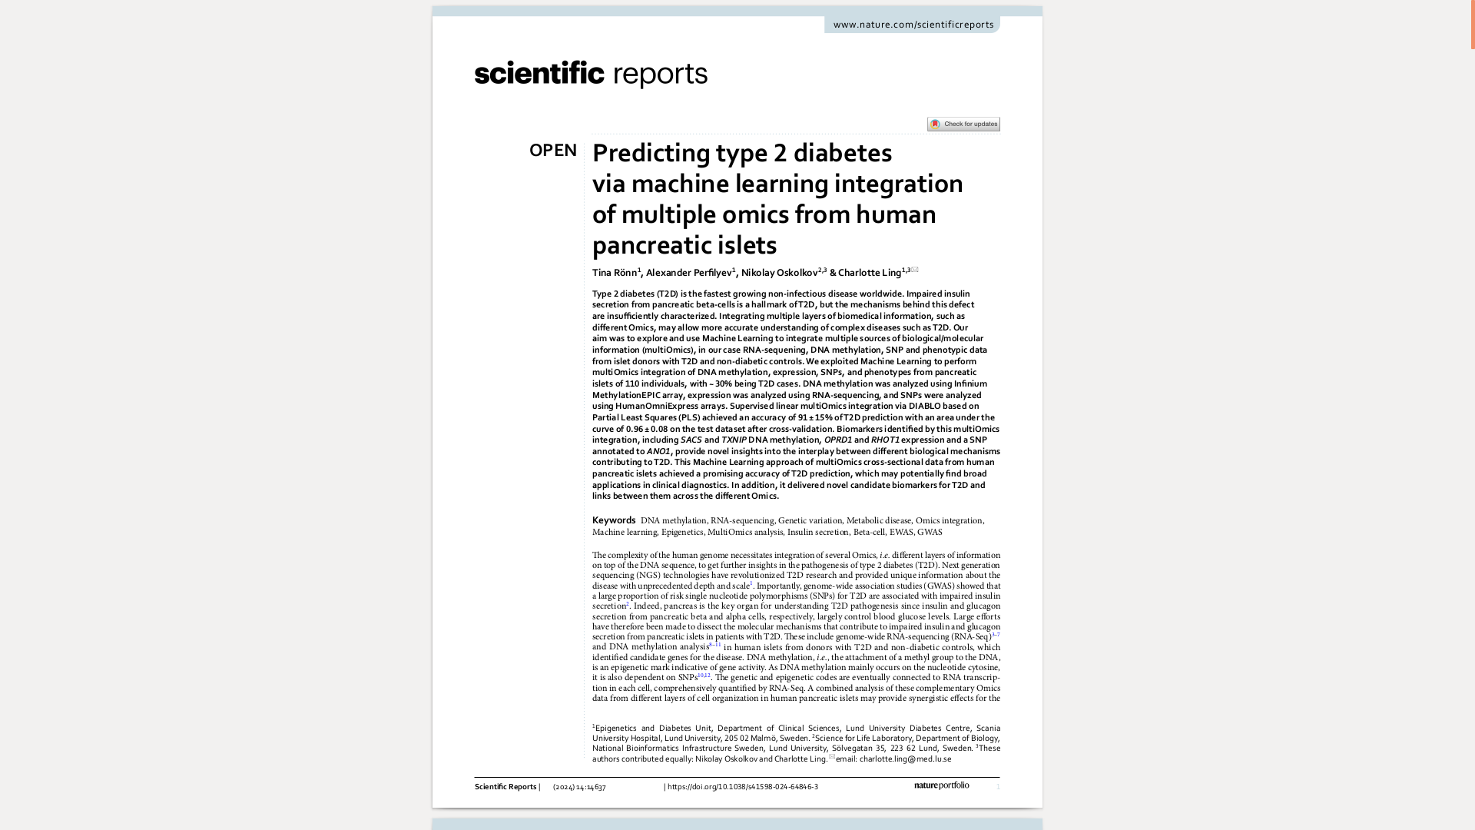
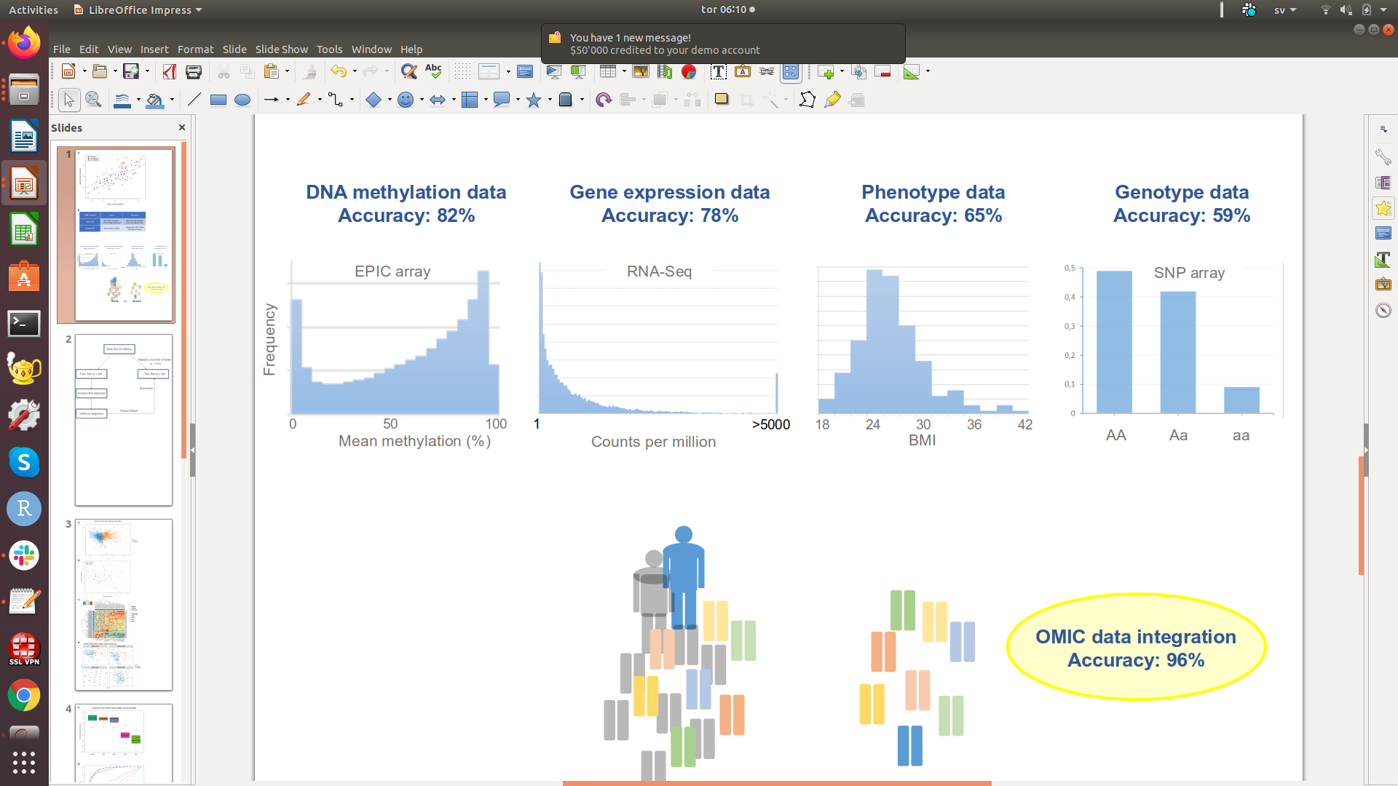
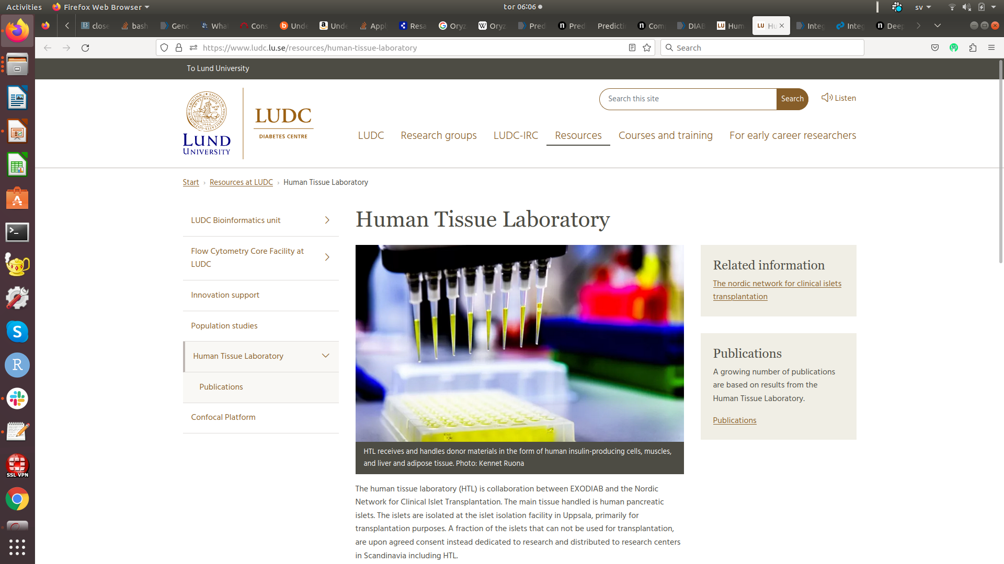
Multi-Omics from human pancreatic islets

Slide 8
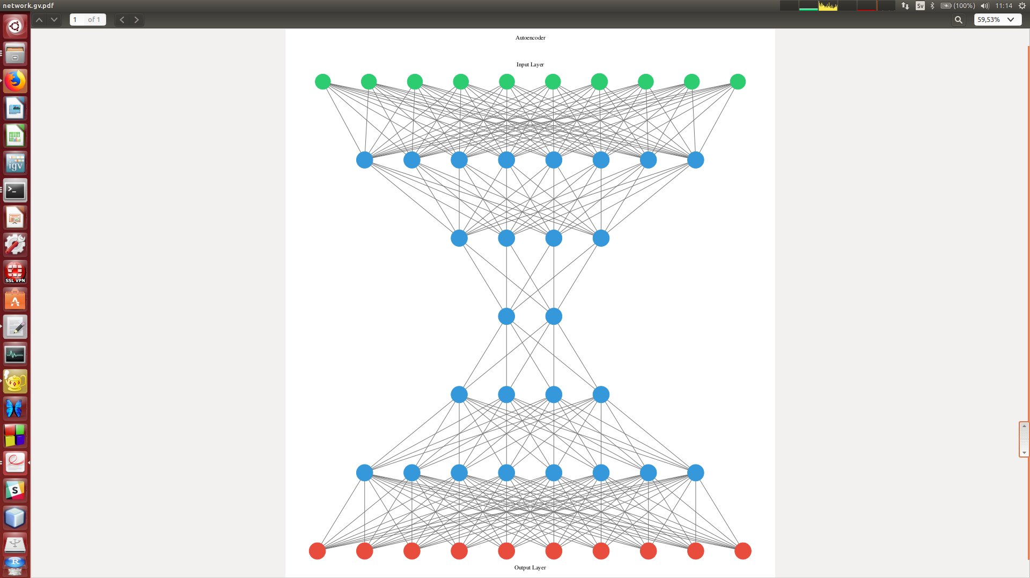
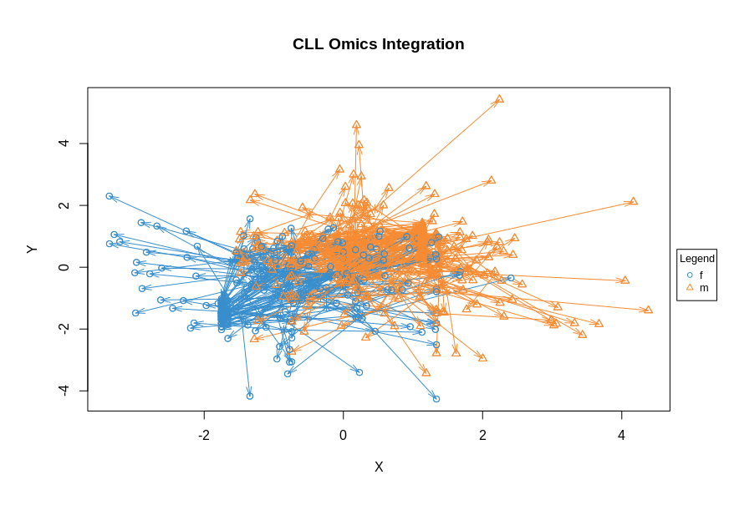
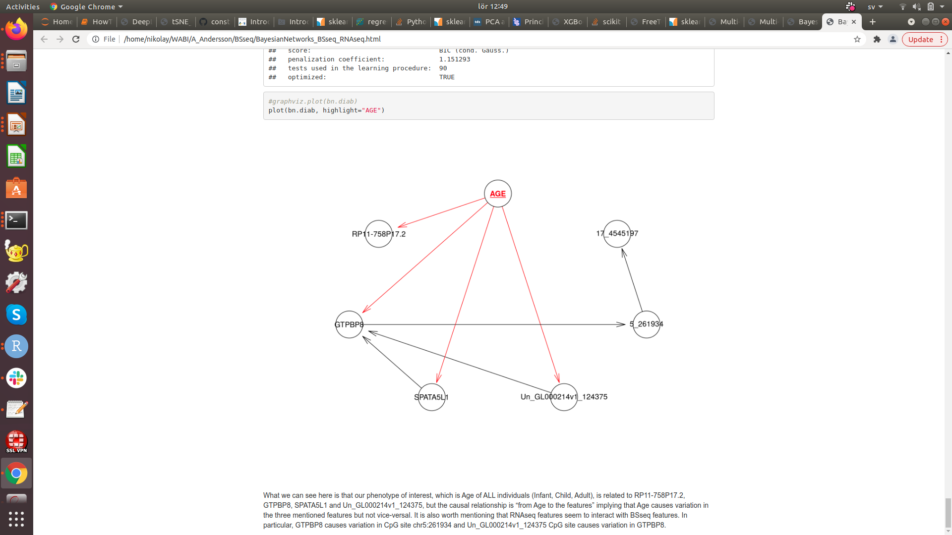
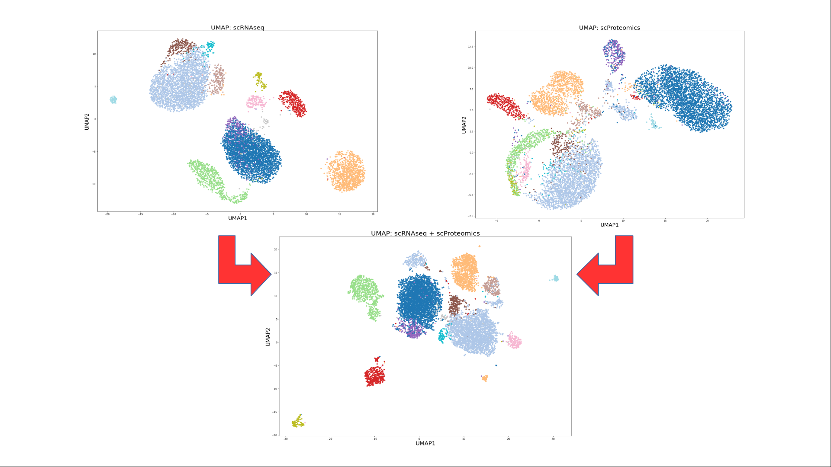
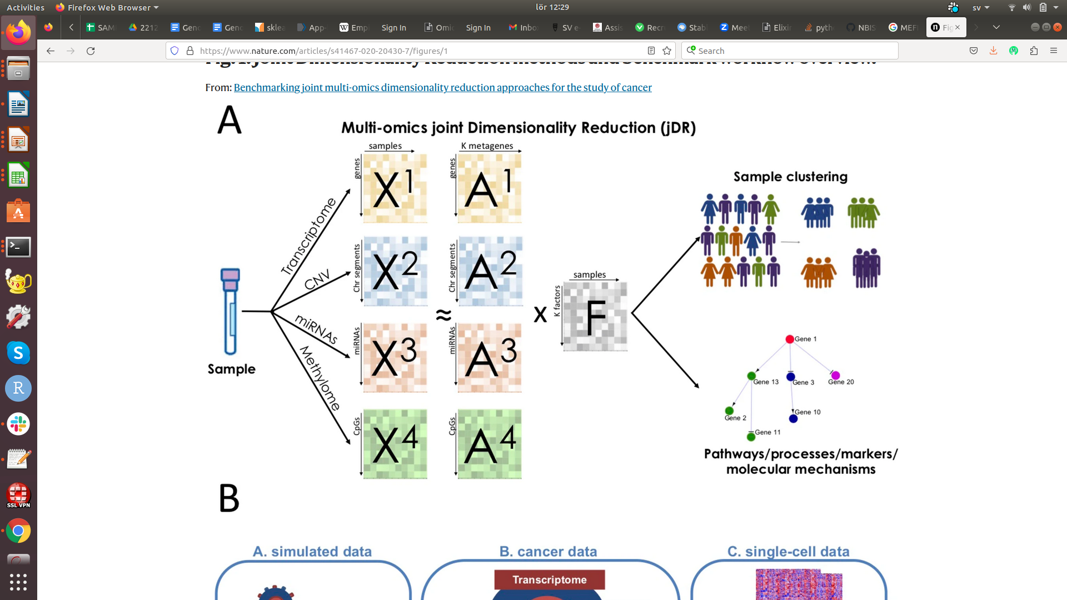

Overview of Integrative Methods
Convert to common space
Extract common variation
Combine via Bayes rule
PLS / CCA
Bayesian networks
Neural nets and graphs
Bayesian factor analysis
UMAP

Slide 9
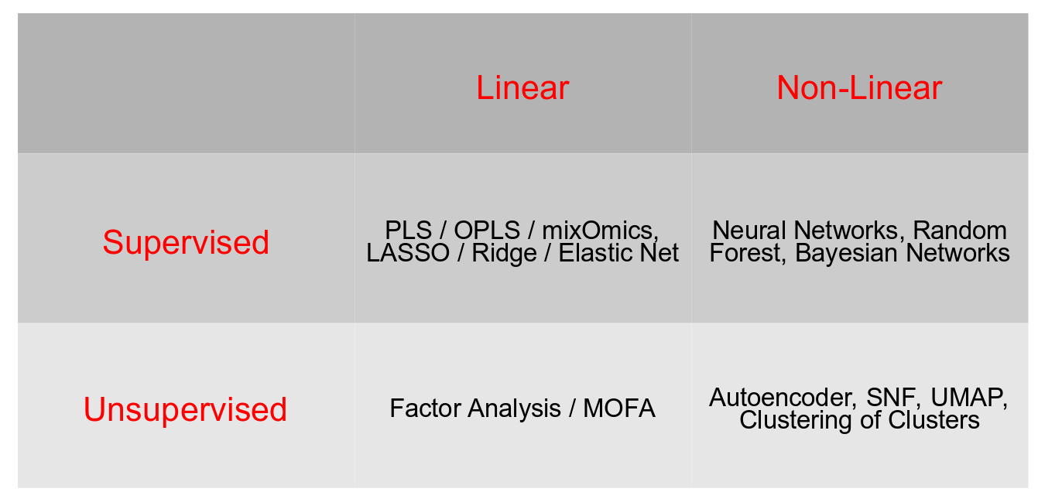
What Method of Integration to Select?
For Example:
1) With ~100 samples it is a good idea to do linear Omics integration
2) T2D is a phenotype of interest, therefore supervised integration

Slide 10
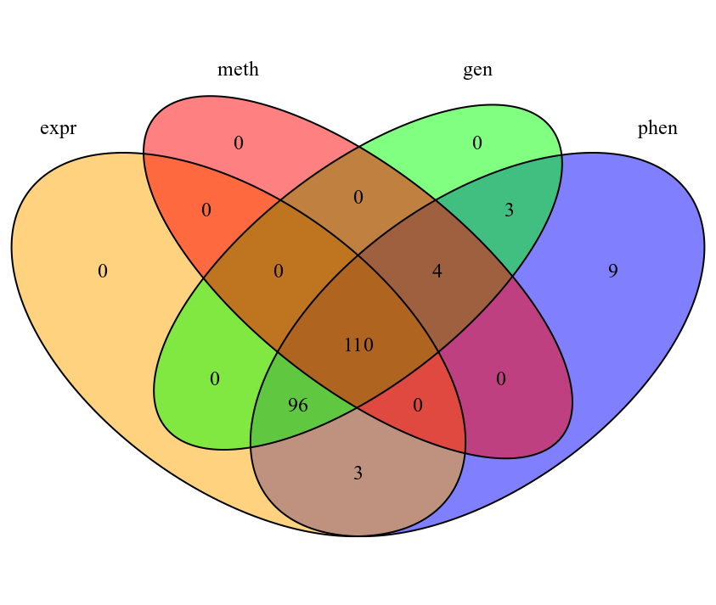
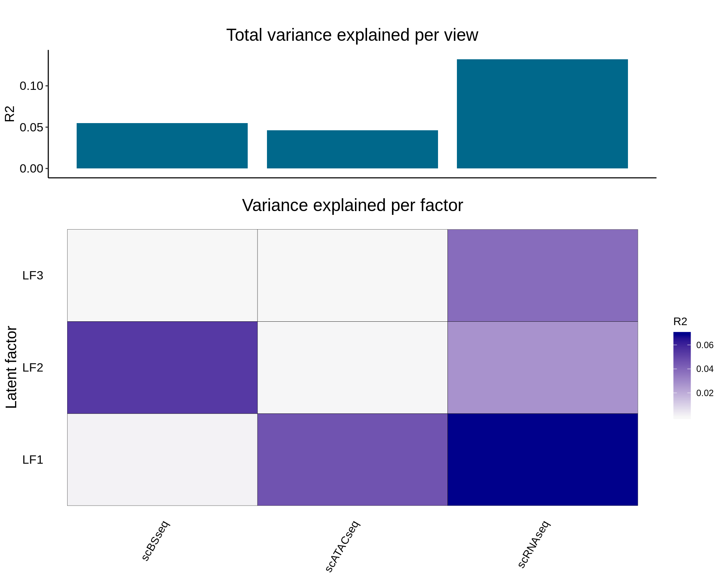
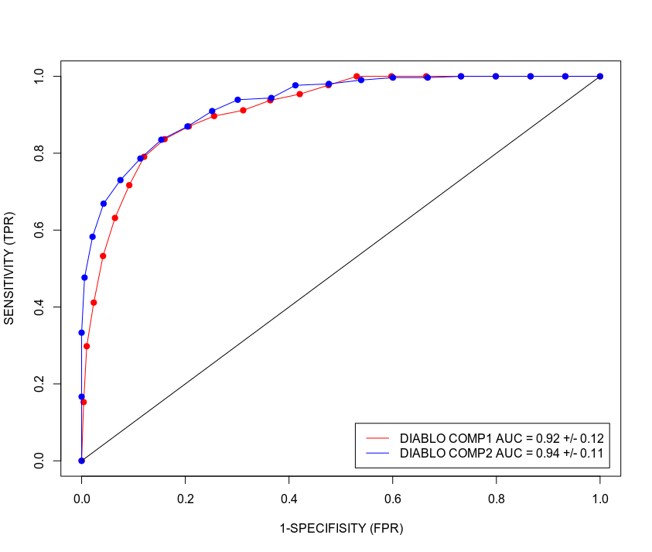
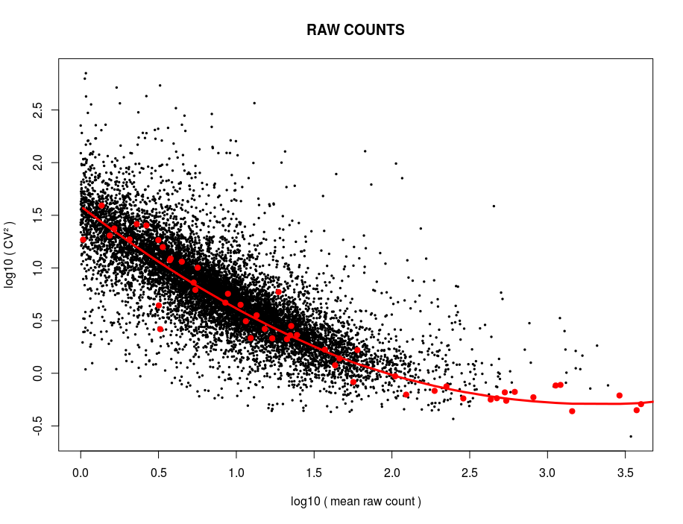

Typical Workflow for Omics Integration
Check covariance
Data Set (4 Omics) 110 overlapping individuals
Train Set (n = 80)
Test Set (n = 30)
Unsupervised: remove low-variance
Supervised: LASSO
Evaluation
Feature Selection
Trained Model
Omics Integration

Slide 11
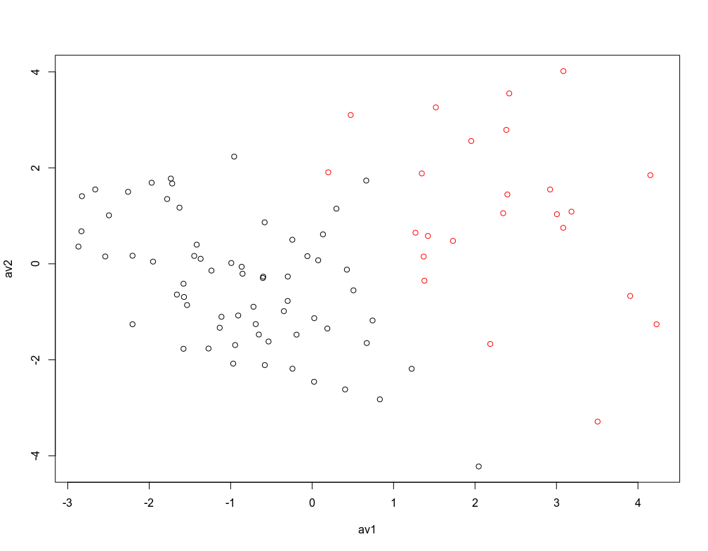
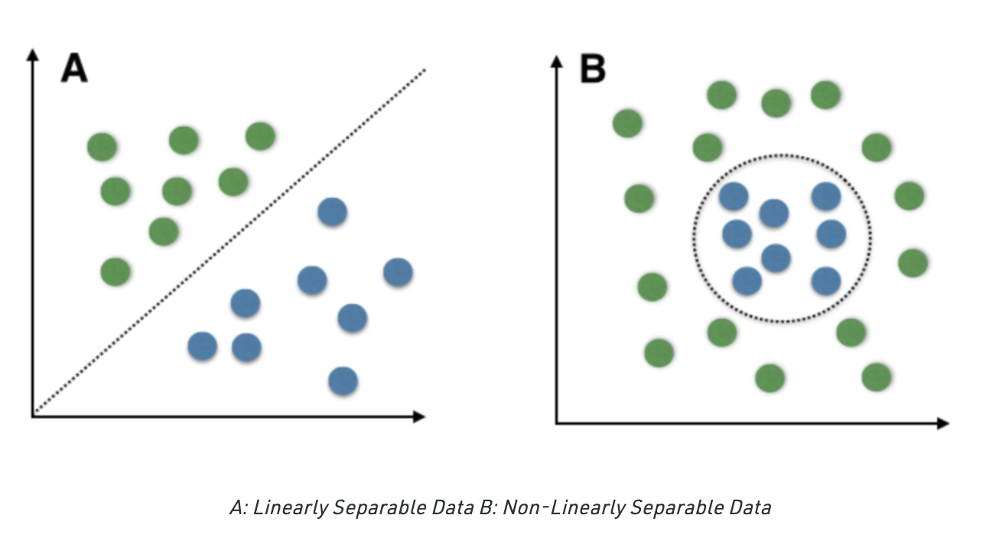
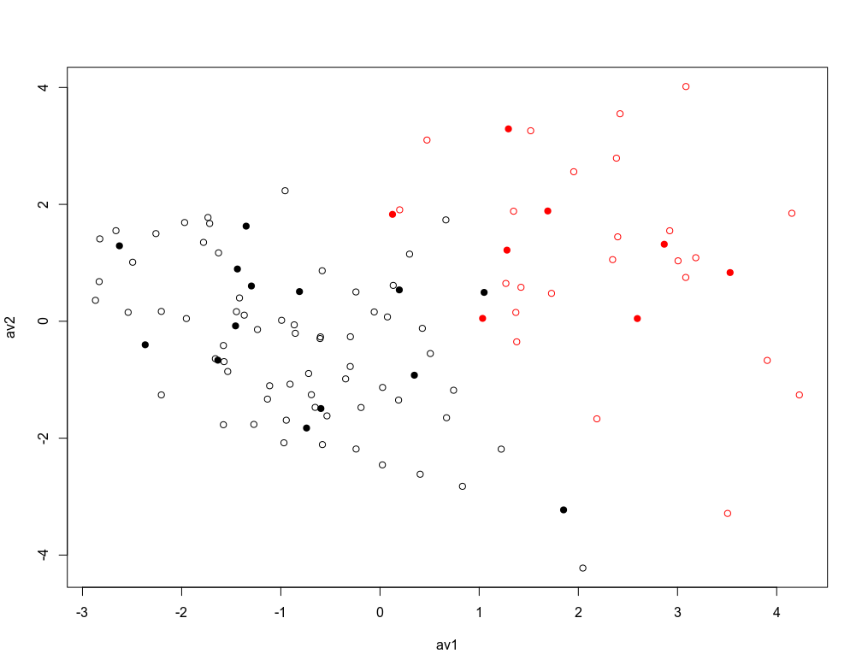
Linear Separation: Decision Boundary
healthy train
sick train
healthy test sick test
Integrative Latent Variable 2
Integrative Latent Variable 1

Slide 12
Univariate and Multivariate
Feature Selection

Slide 13
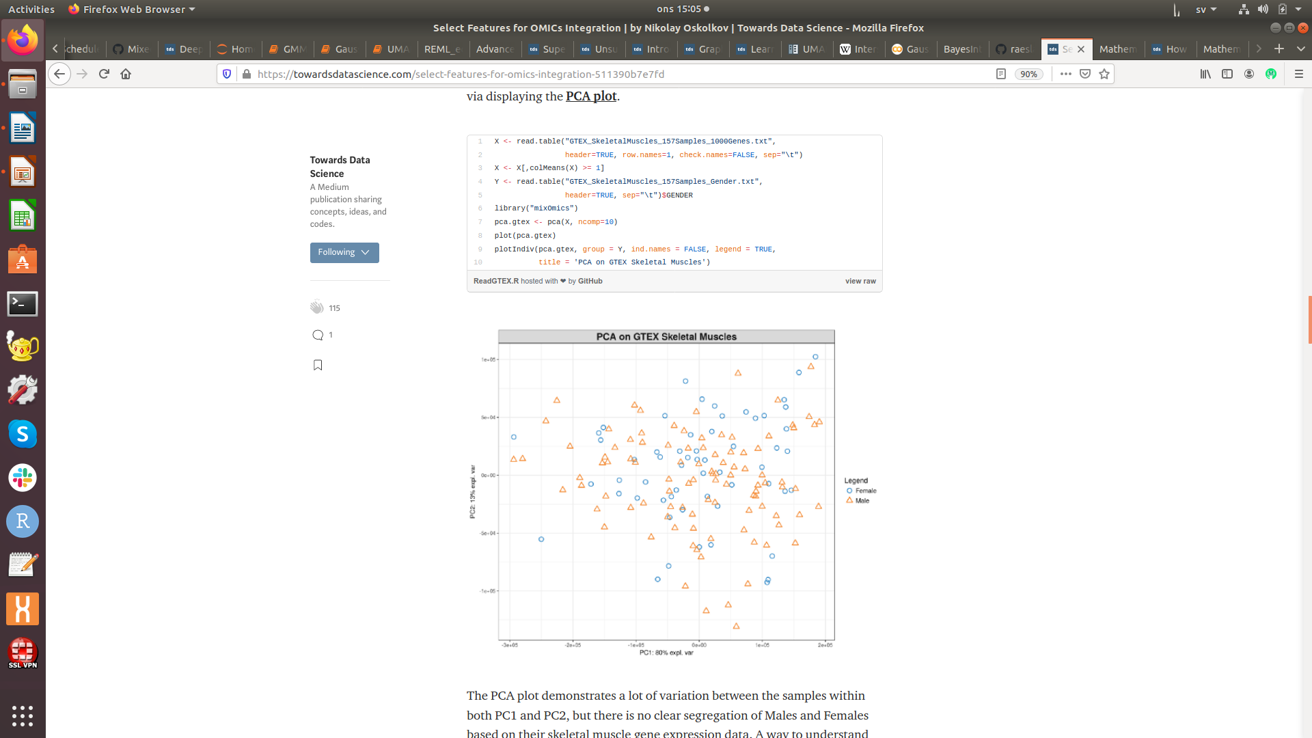
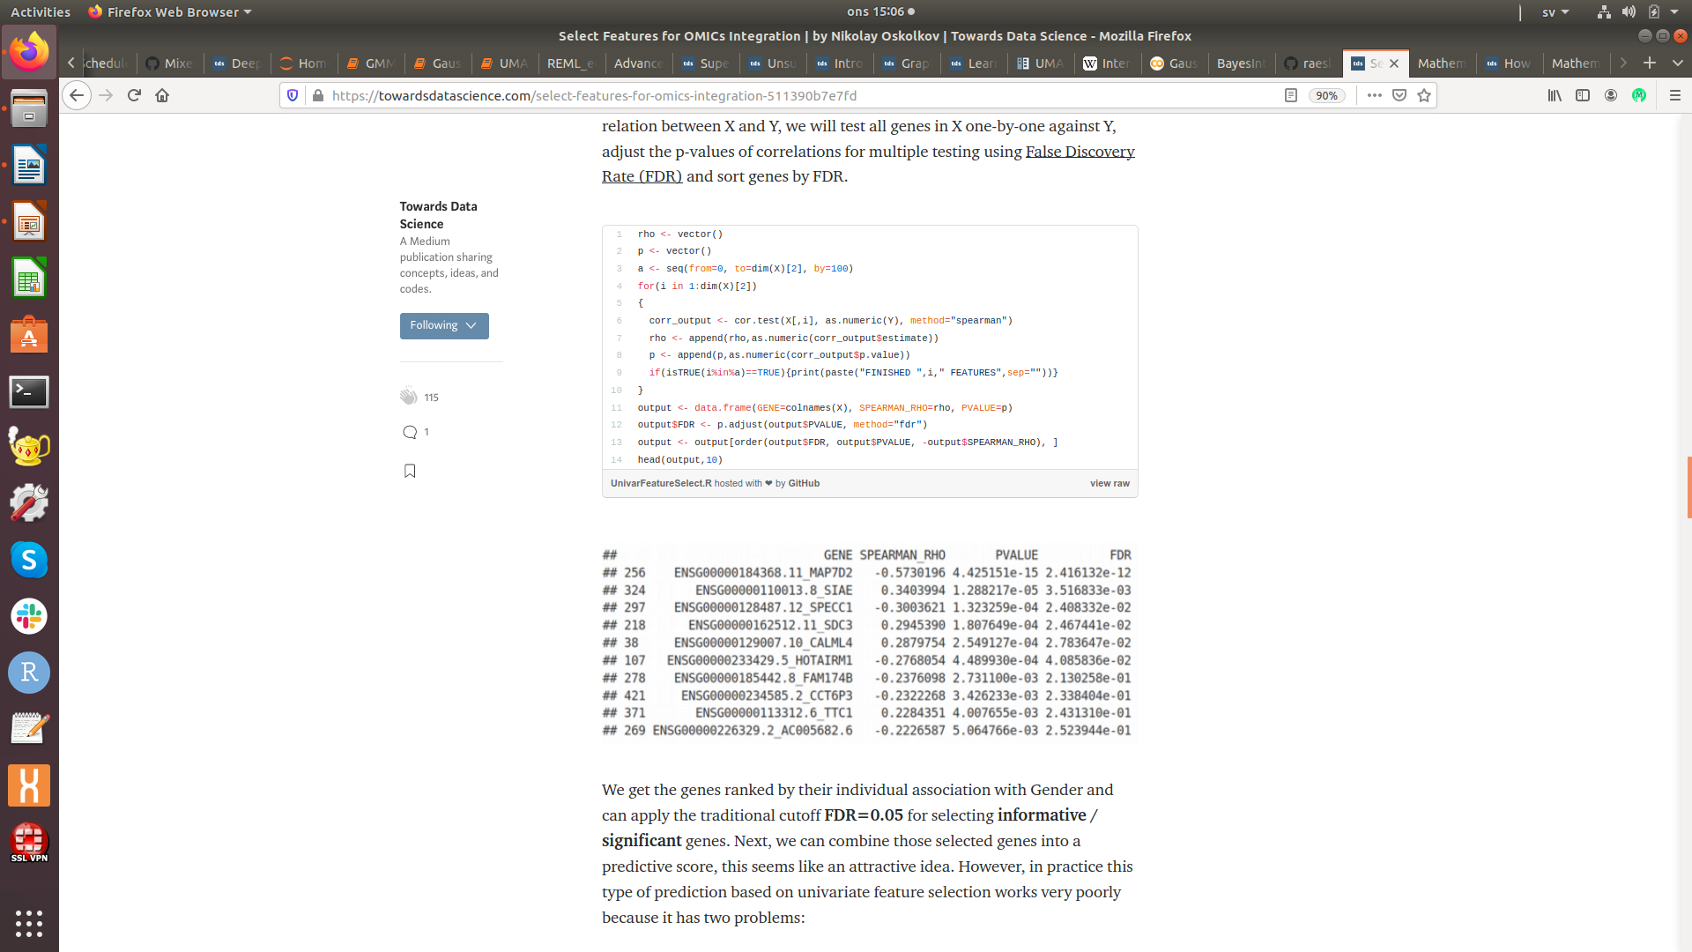
Univariate Feature Selection
Generally acknowledged that univariate feature selection has poor predictive capacity compared to multivariate feature selection

Slide 14
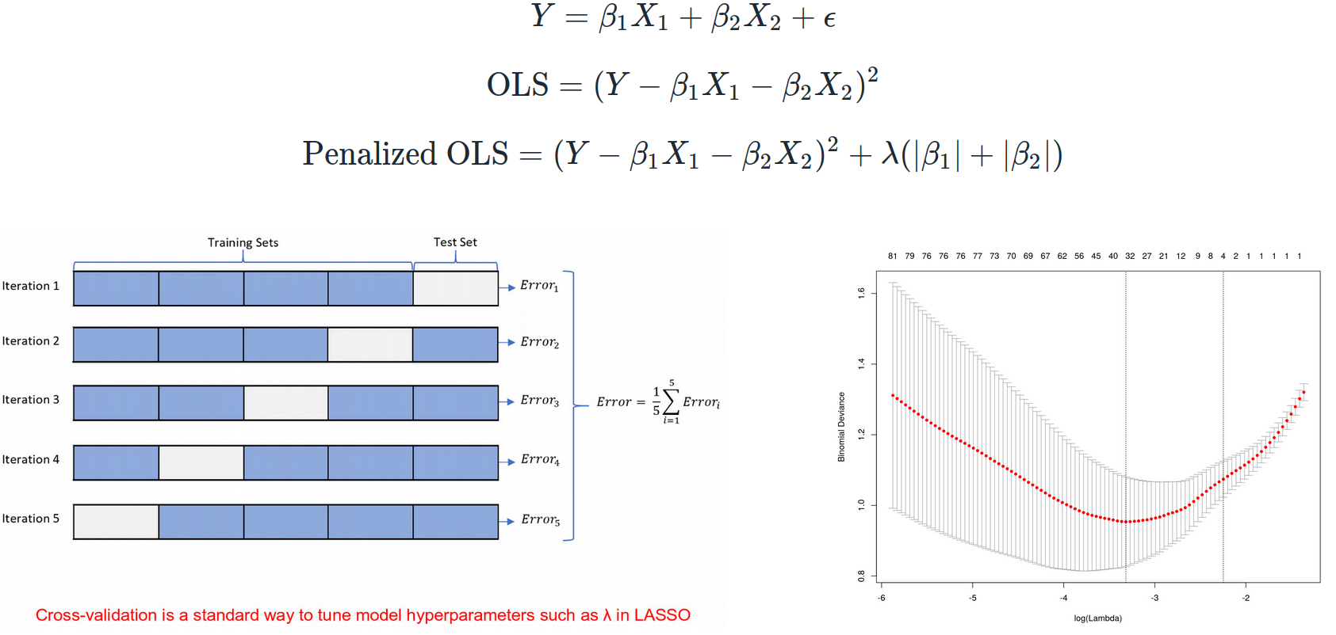
Multivariate Feature Selection: LASSO

Slide 15
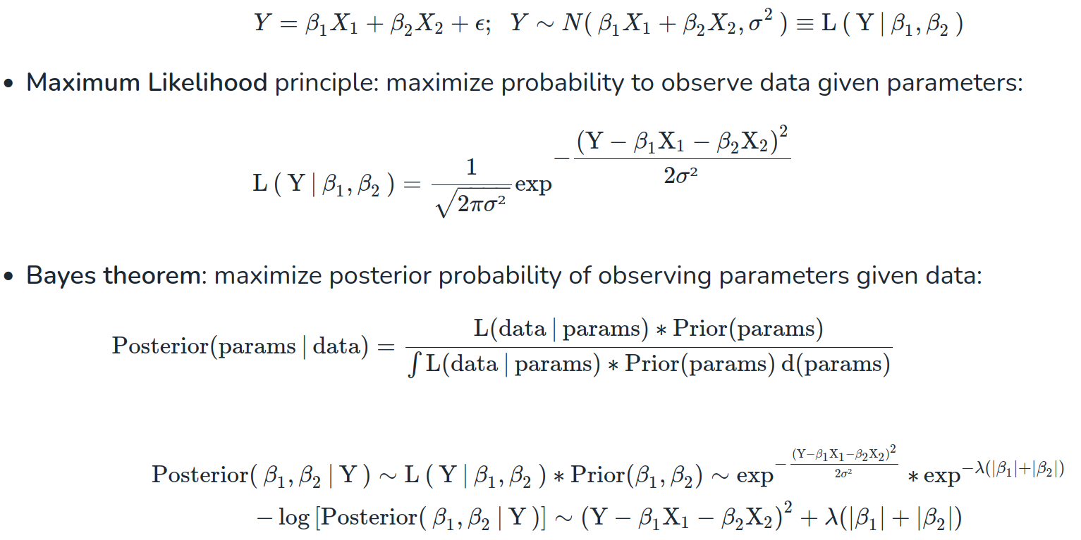
Regularizations are Priors in Bayesian stats

Slide 16
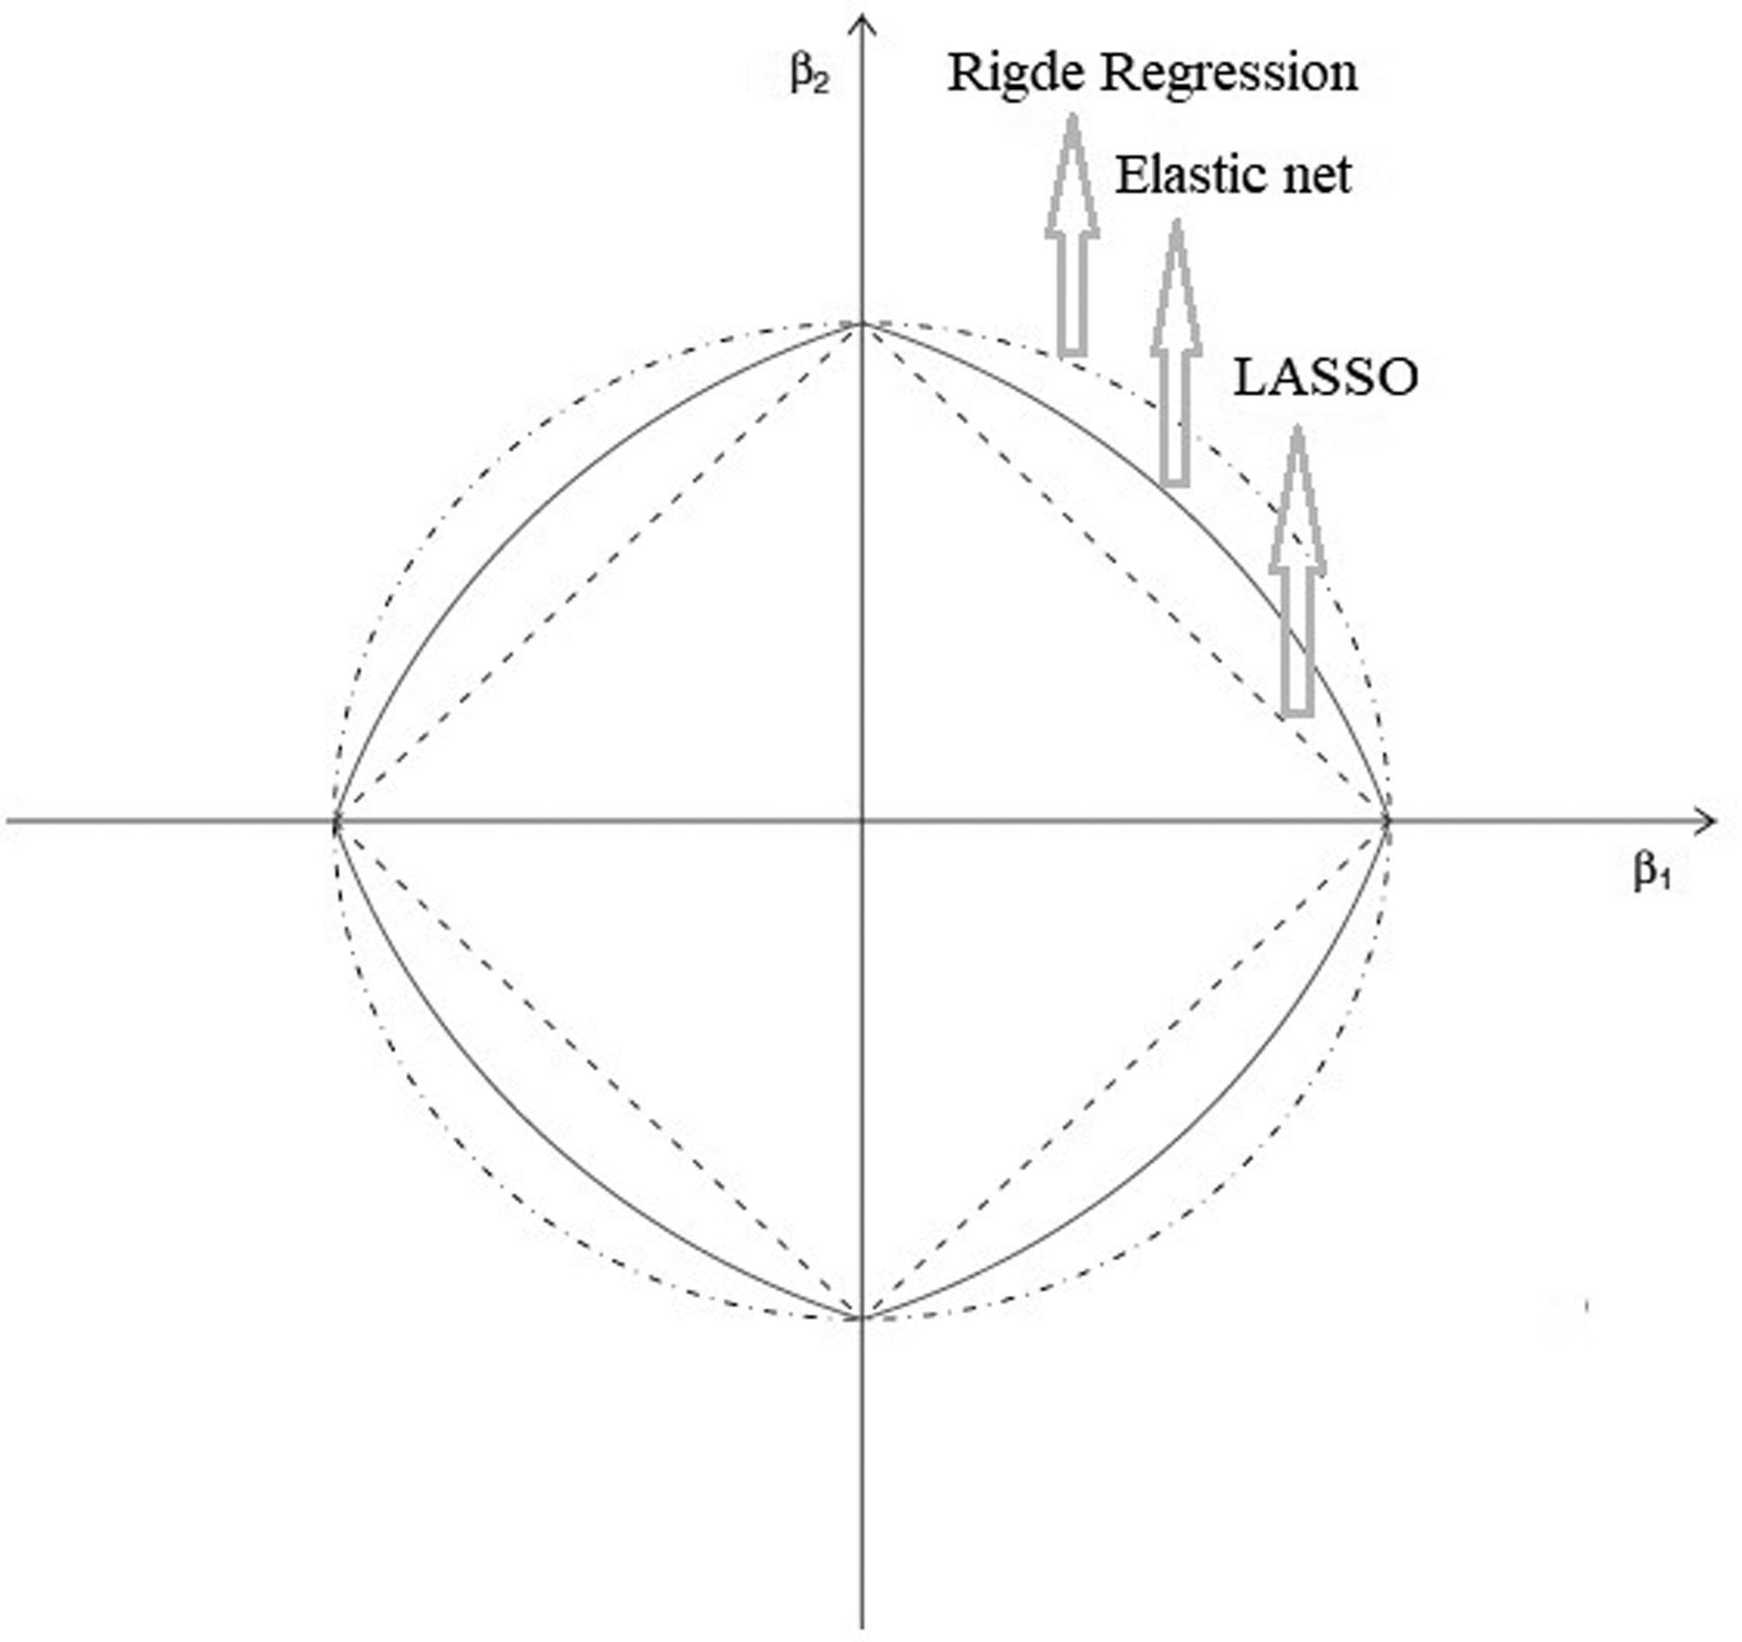
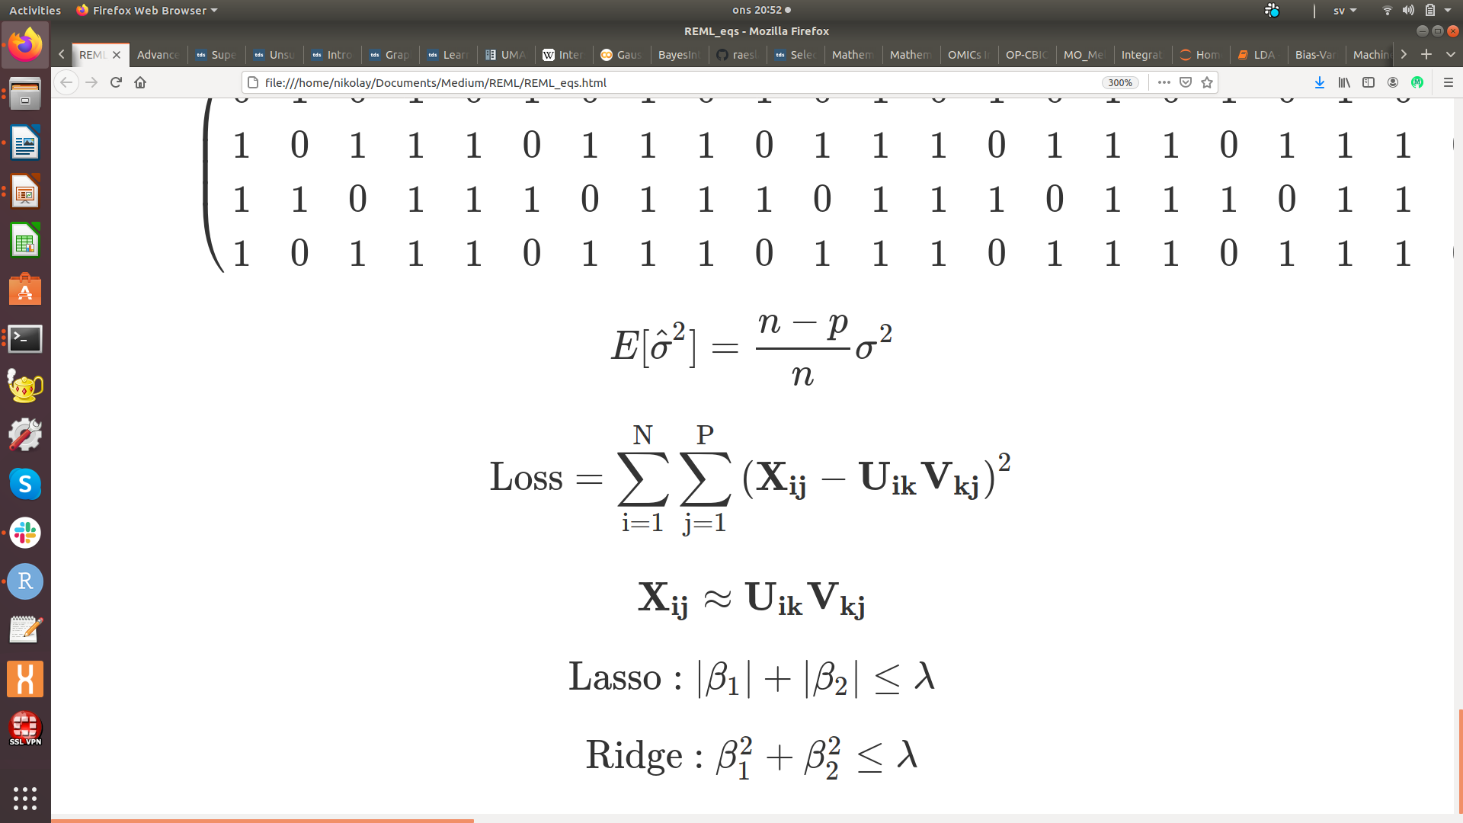
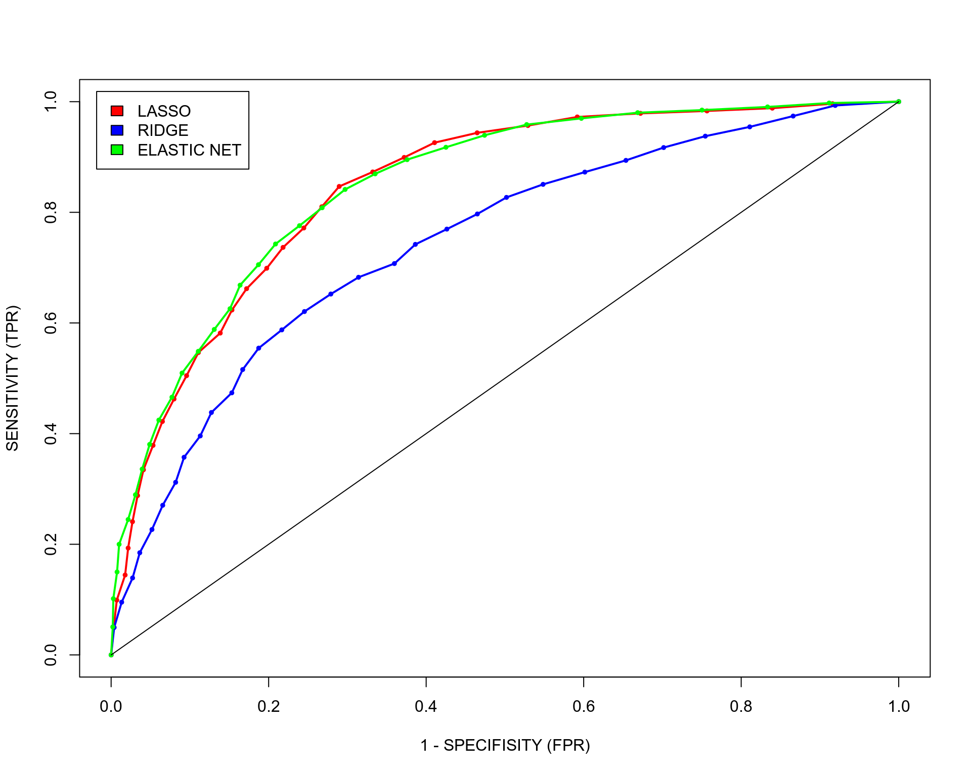
Lasso vs. Ridge vs. Elastic Net
Lasso is more conservative
Ridge is more permissive

Slide 17
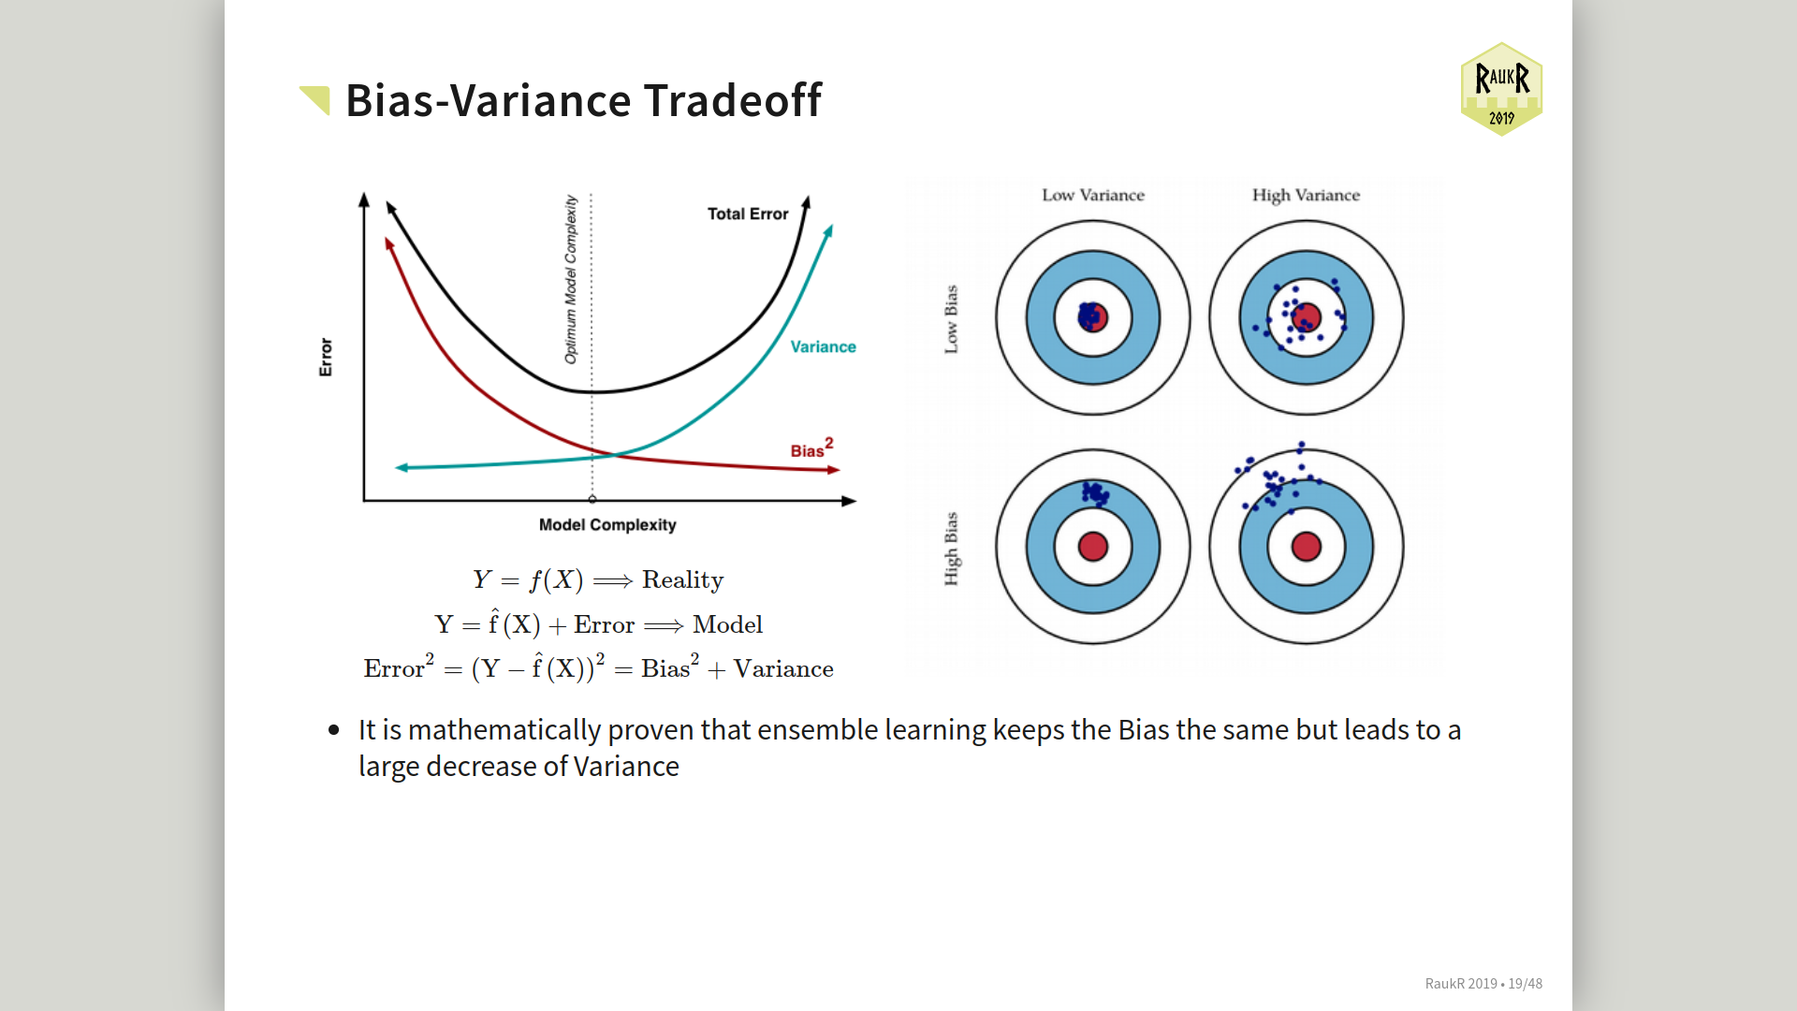
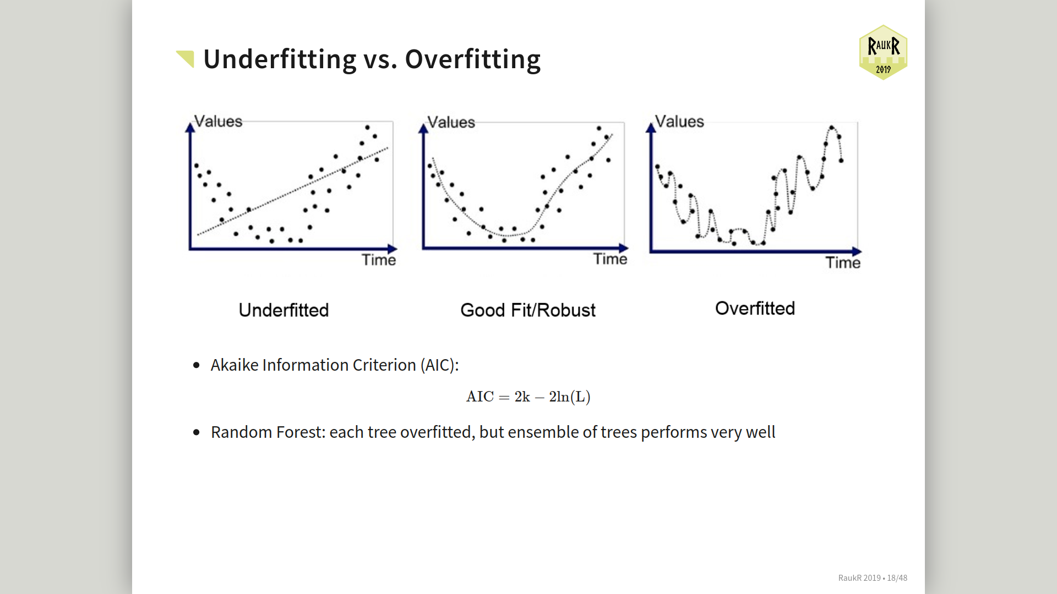
Penalized regression interpretation
LASSO – high bias, low variance

Slide 18
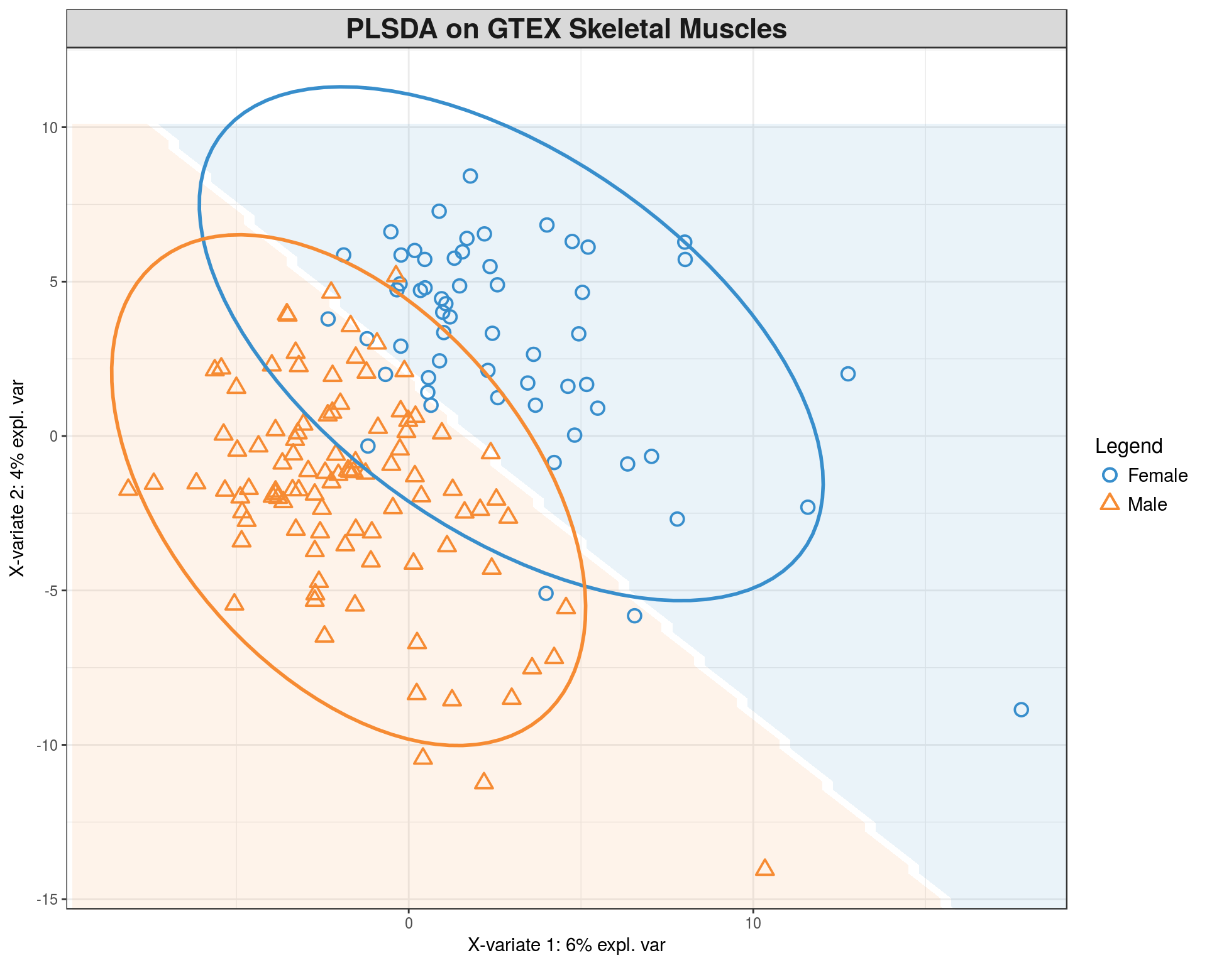
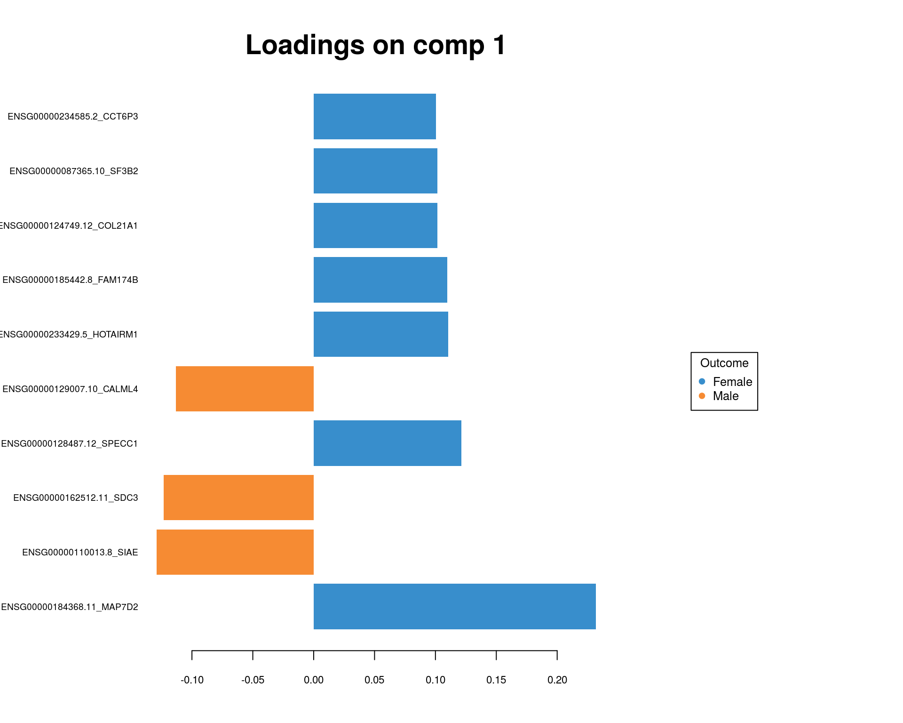
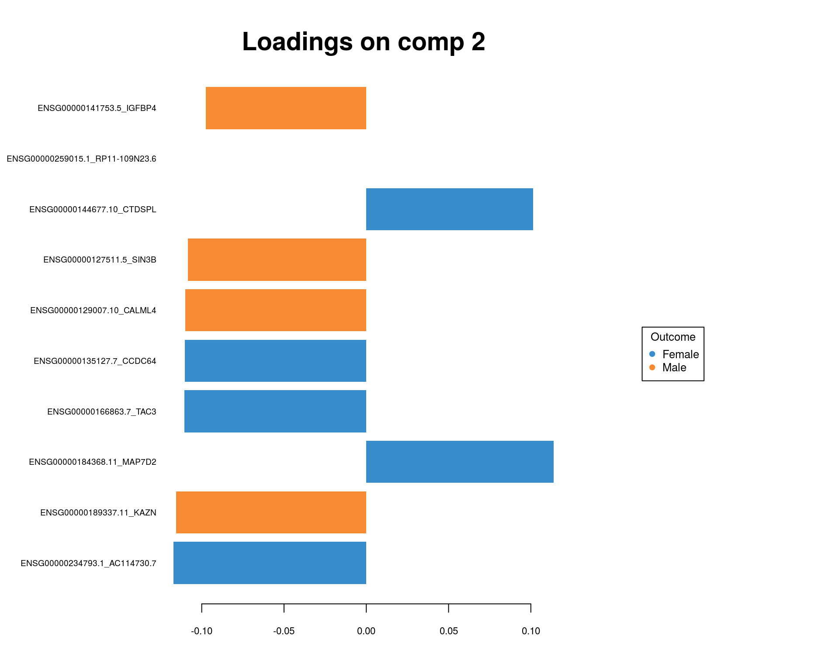
Multivariate Feature Selection: PLS
Select features that separate two groups of samples the most

Slide 19
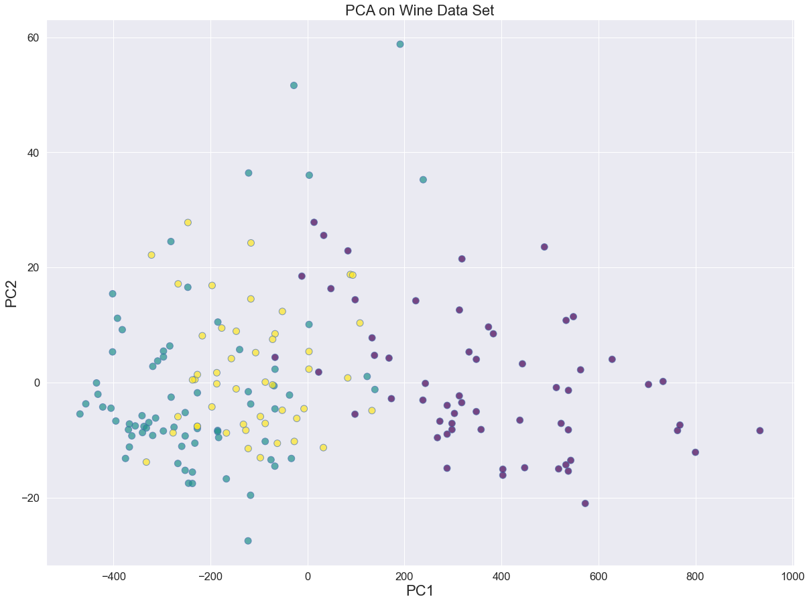
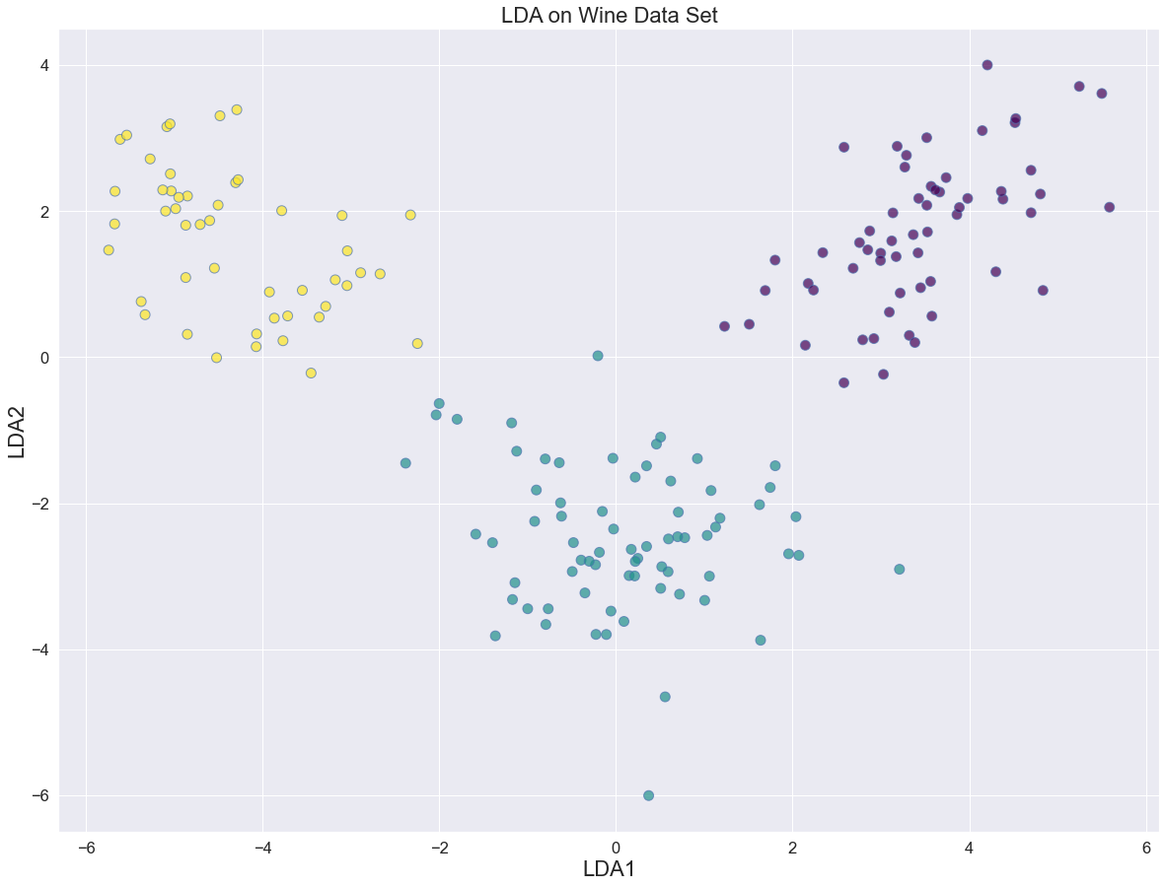
Multivariate Feature Selection: Linear Discriminant Analysis (LDA)
Minimize variance within clusters and maximize variance between clusters
Similar to what ANOVA is doing, therefore LINEAR Discriminant Analysis (LDA)

Slide 20
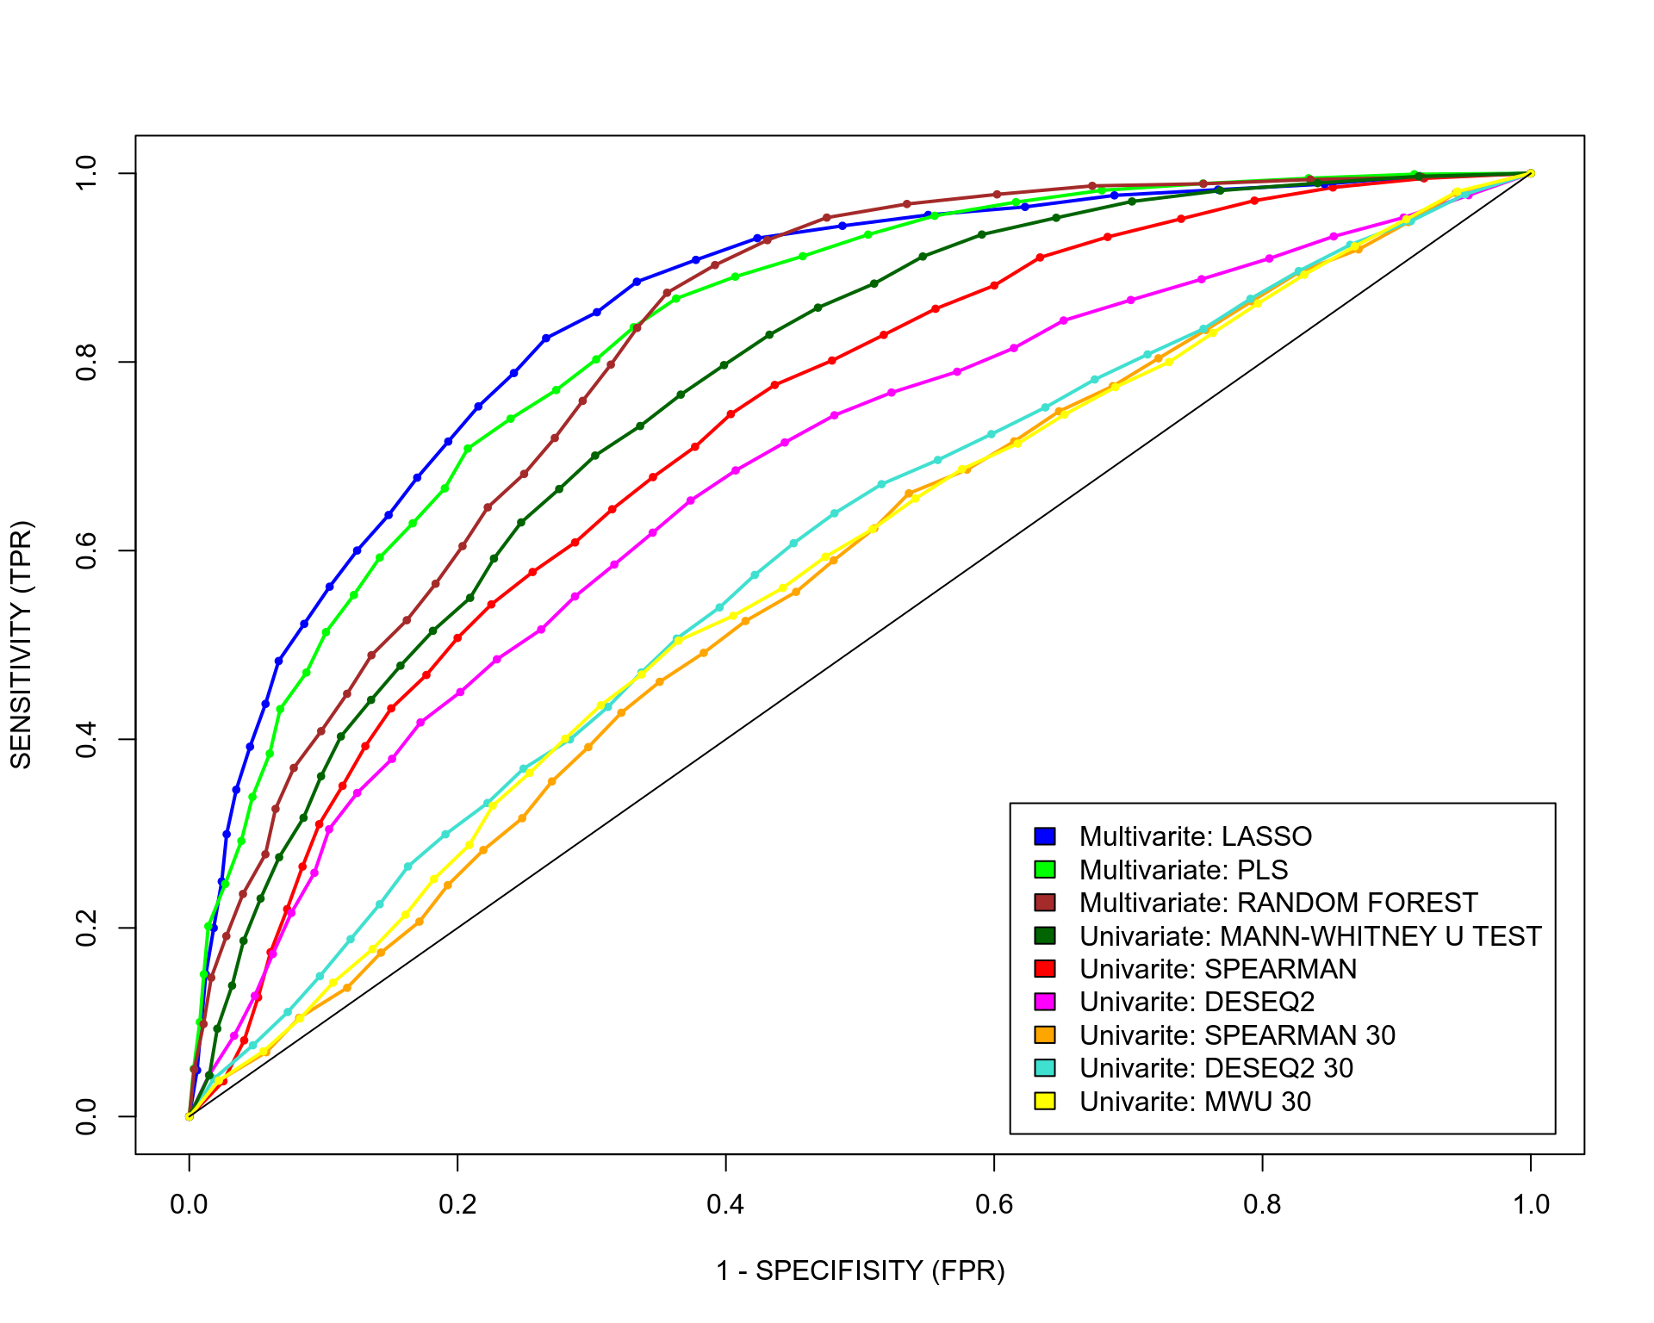
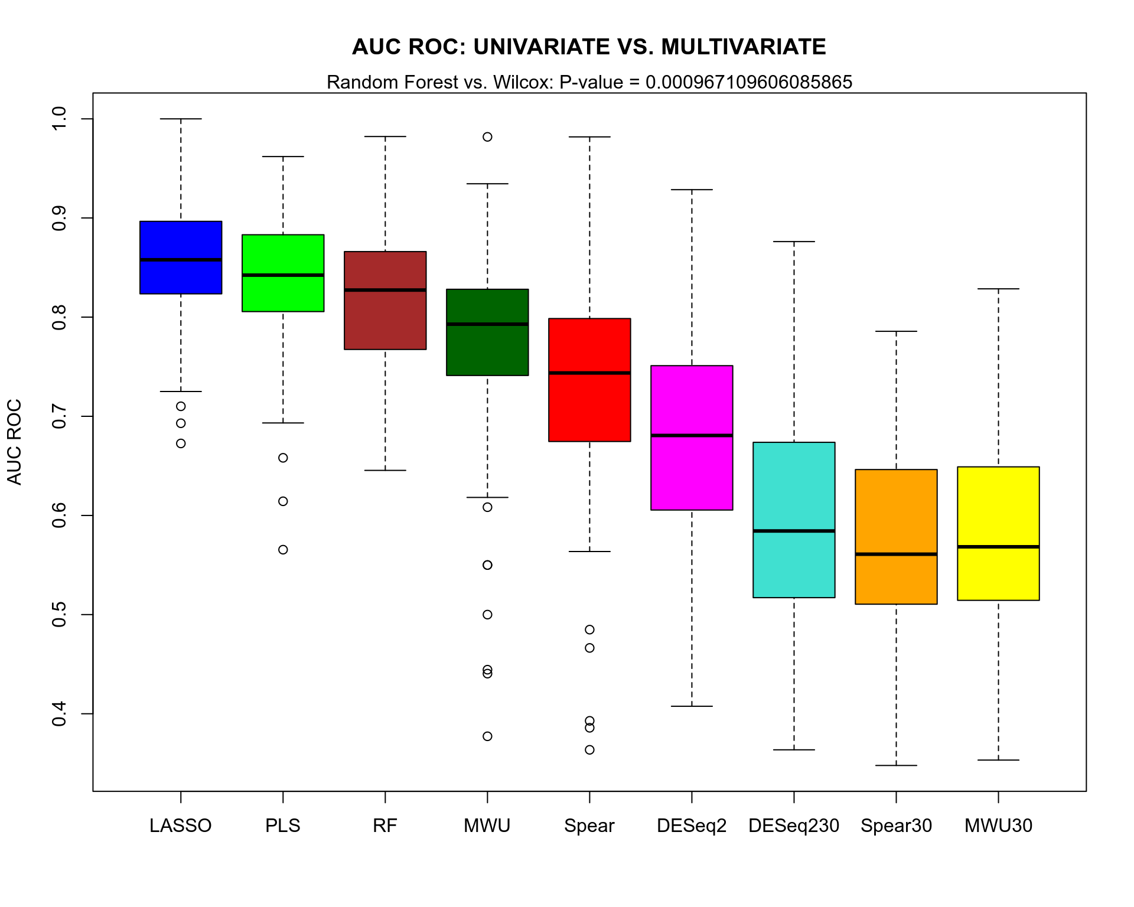
Univariate vs. Multivariate Prediction
Multivariate methods (LASSO, PLS, RanFor) have significantly higher AUC ROC than univariate methods (Spear, MWU, DESeq2) on skeletal muscle gene expression data
If you find a dataset where univariate feature selection has higher predictive capacity than multivariate one, please let me know

Slide 21
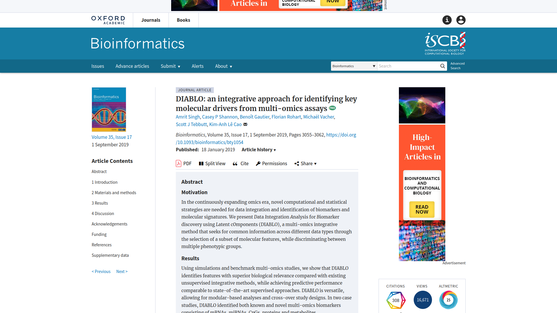

DIABLO Omics Integration

Slide 22
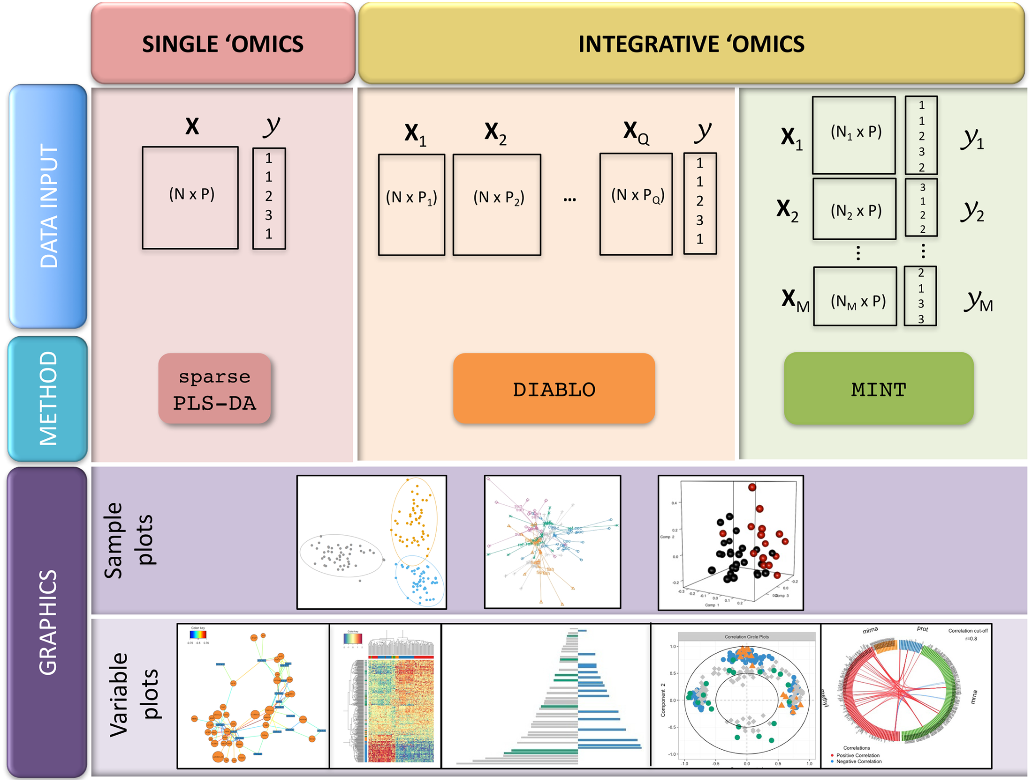
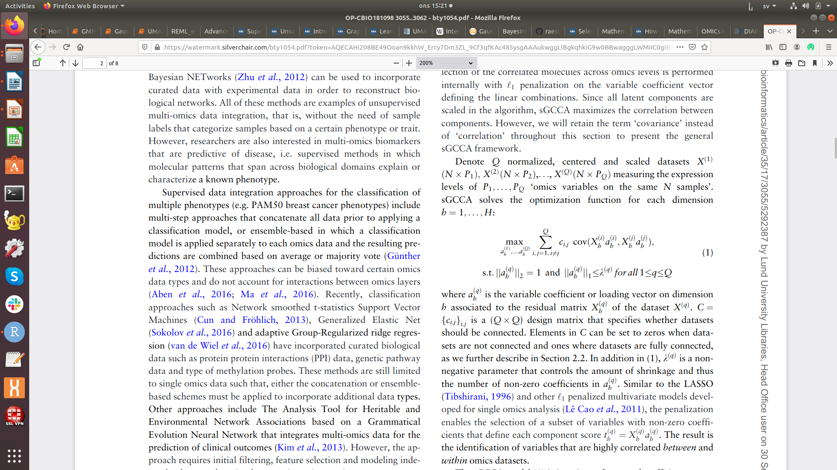
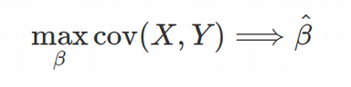
DIABLO PLS-based algorithm

Slide 23
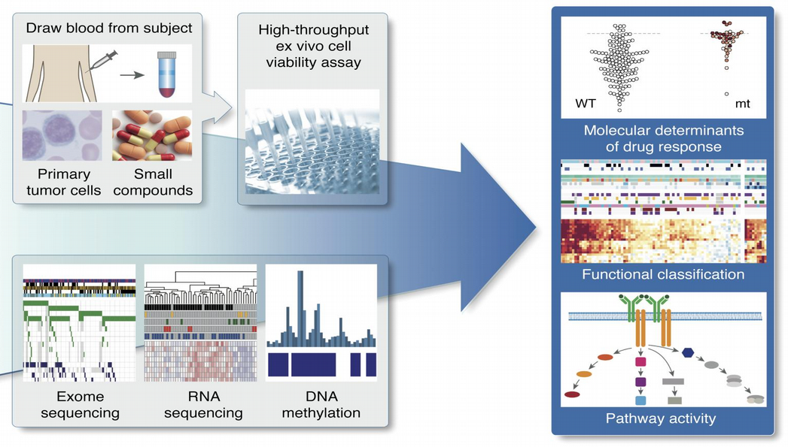
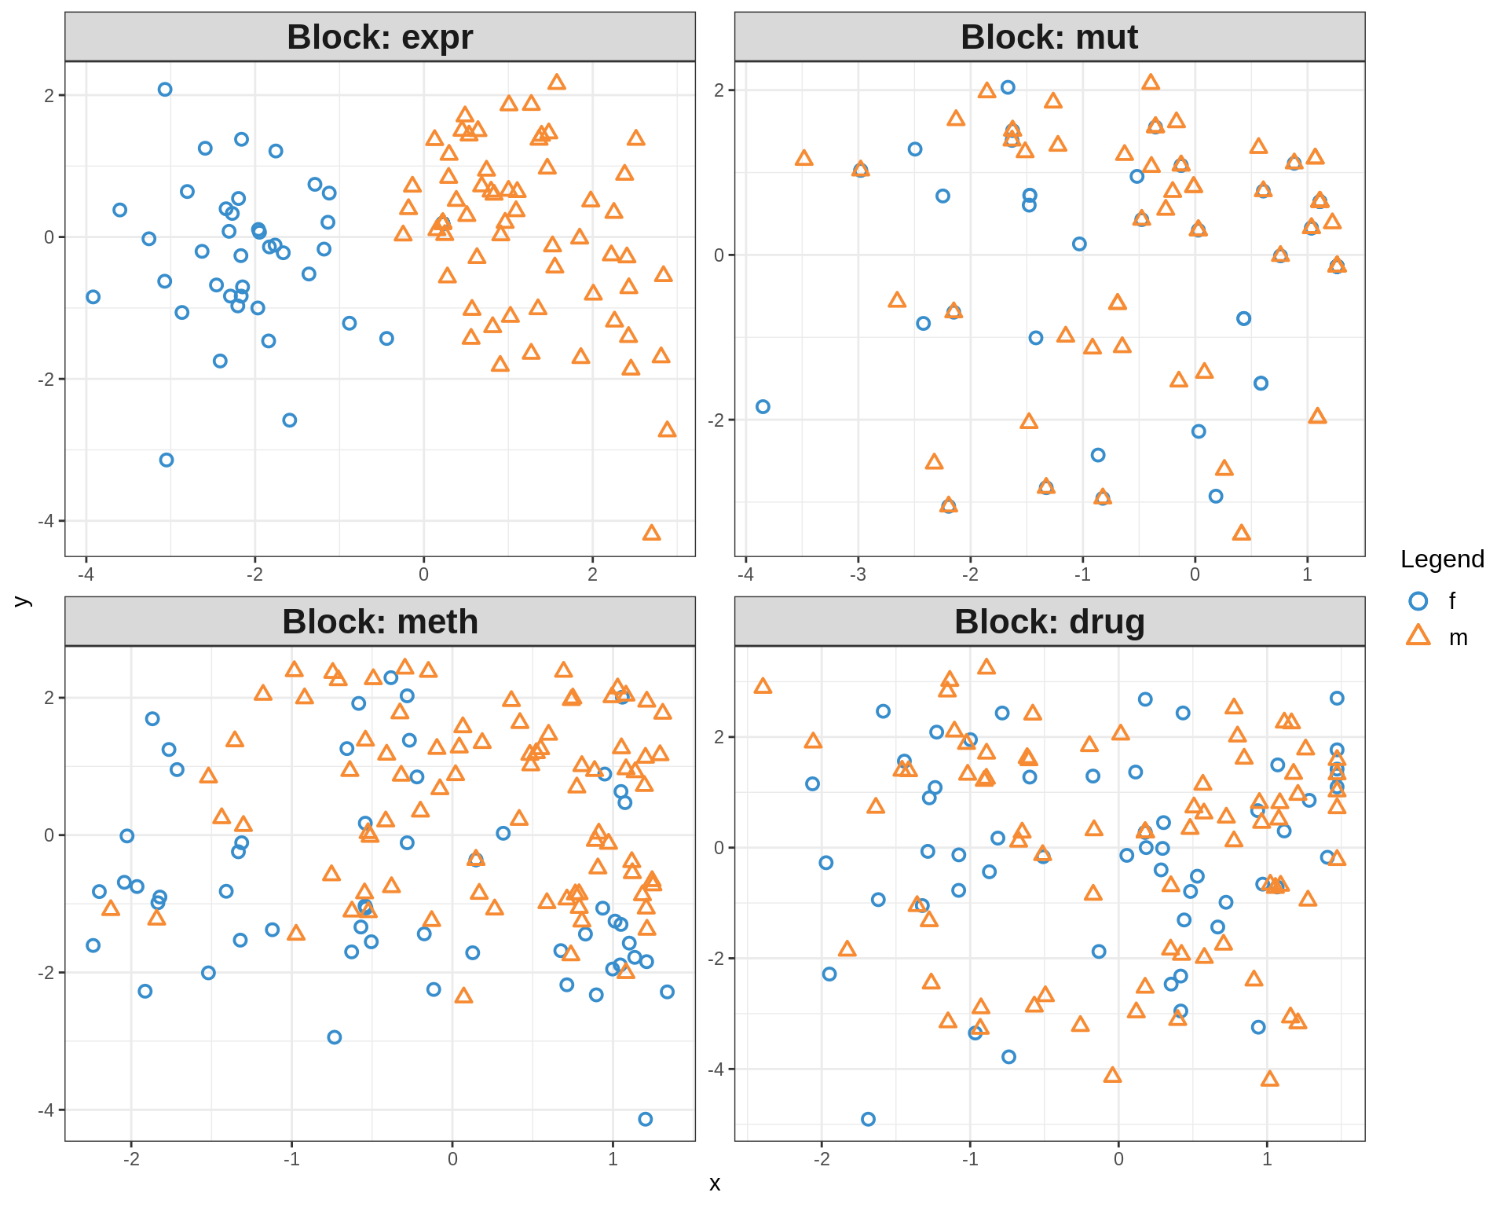
DIABLO Omics Integration
Chronic Lymphocytic Leukaemia (CLL):
gene expression (RNAseq), mutations, methylation, drug response
Dietrich et al., J Clin Invest. 2018

Slide 24
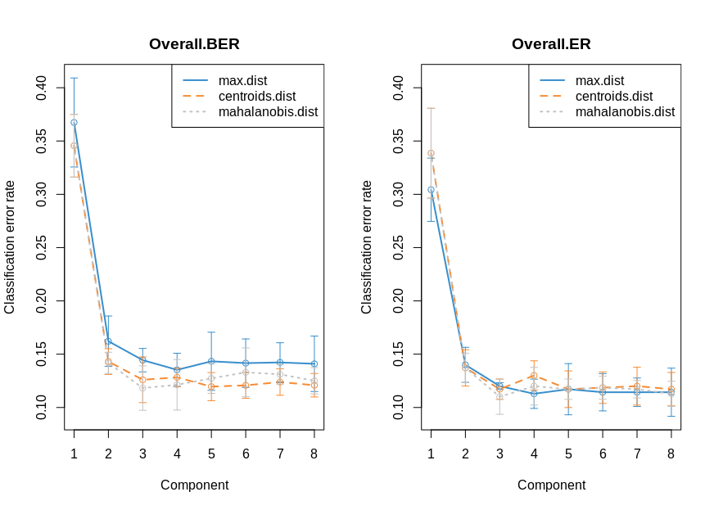
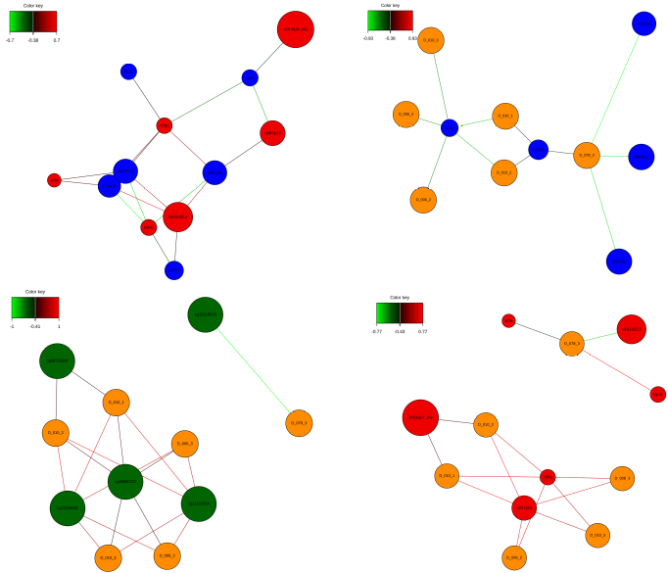
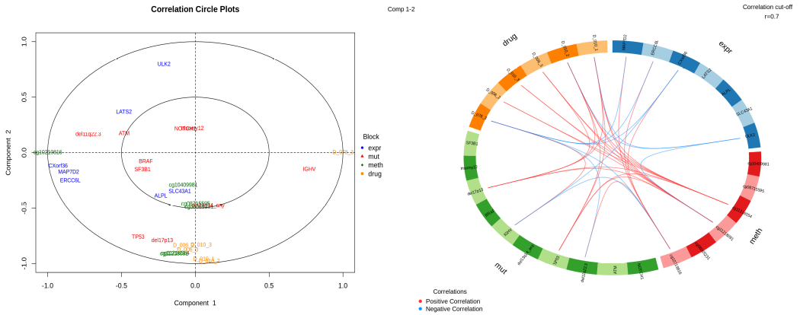
DIABLO visualization

Slide 25
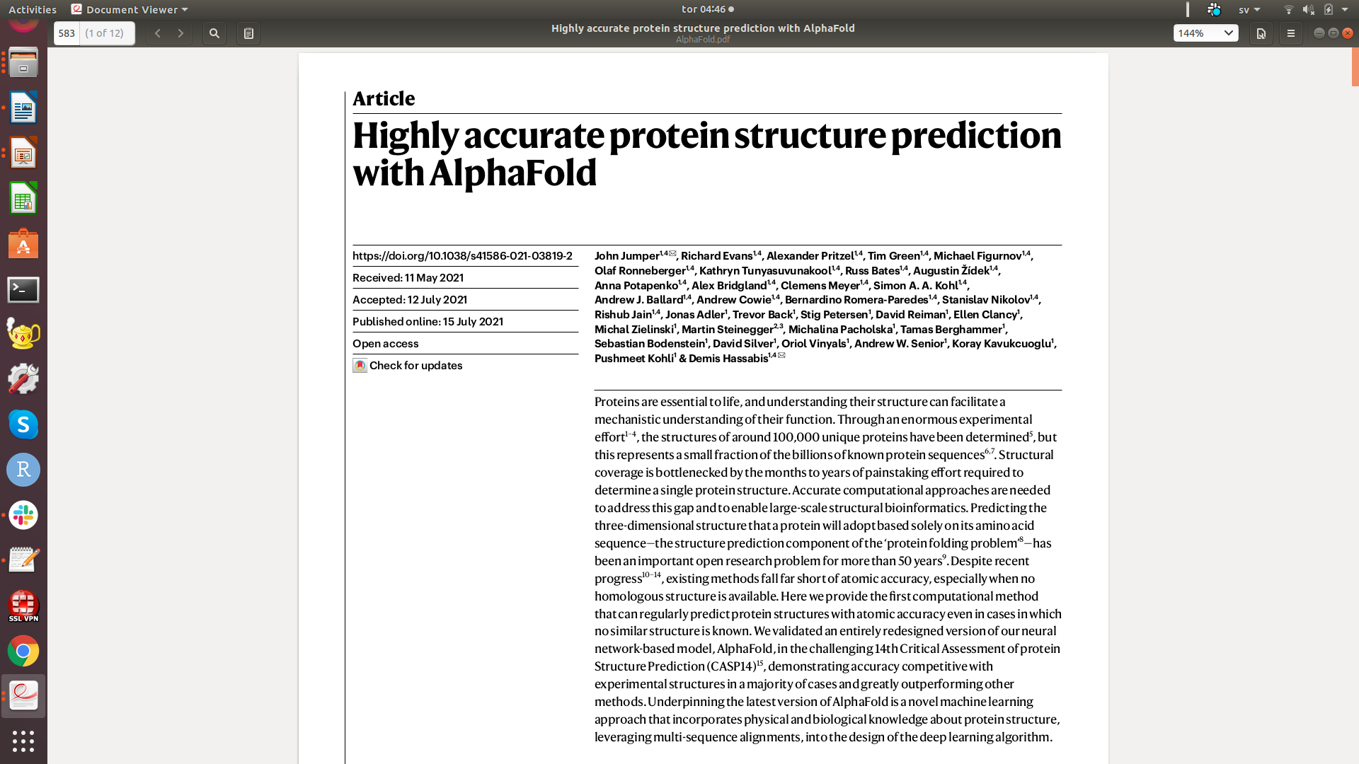
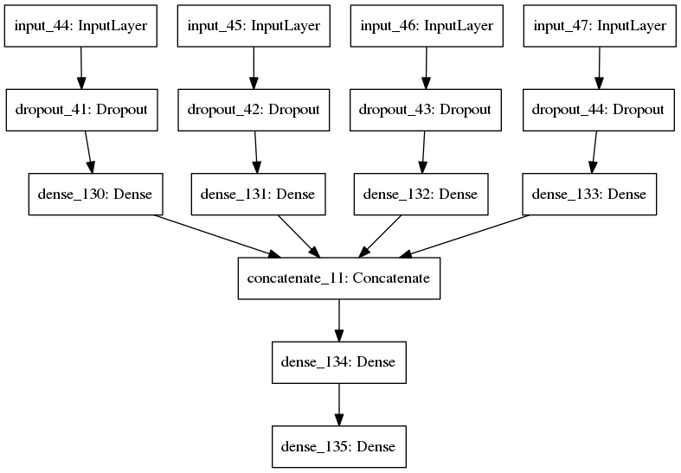
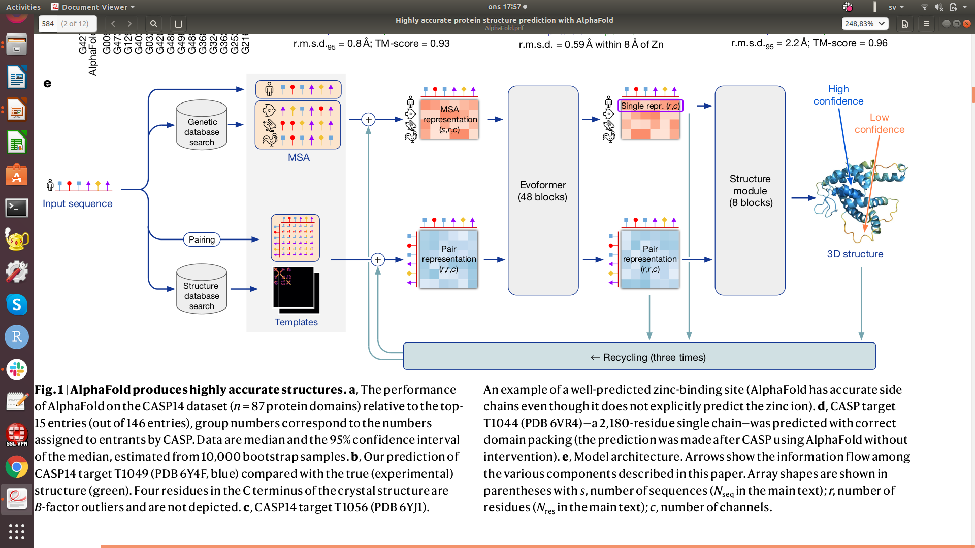
Supervised deep learning Omics integration
OMIC1
OMIC2
OMIC3
OMIC3
Integration
Prediction
Backward propagation ensures that the parameters across Omics are optimized in context of each other

Slide 26
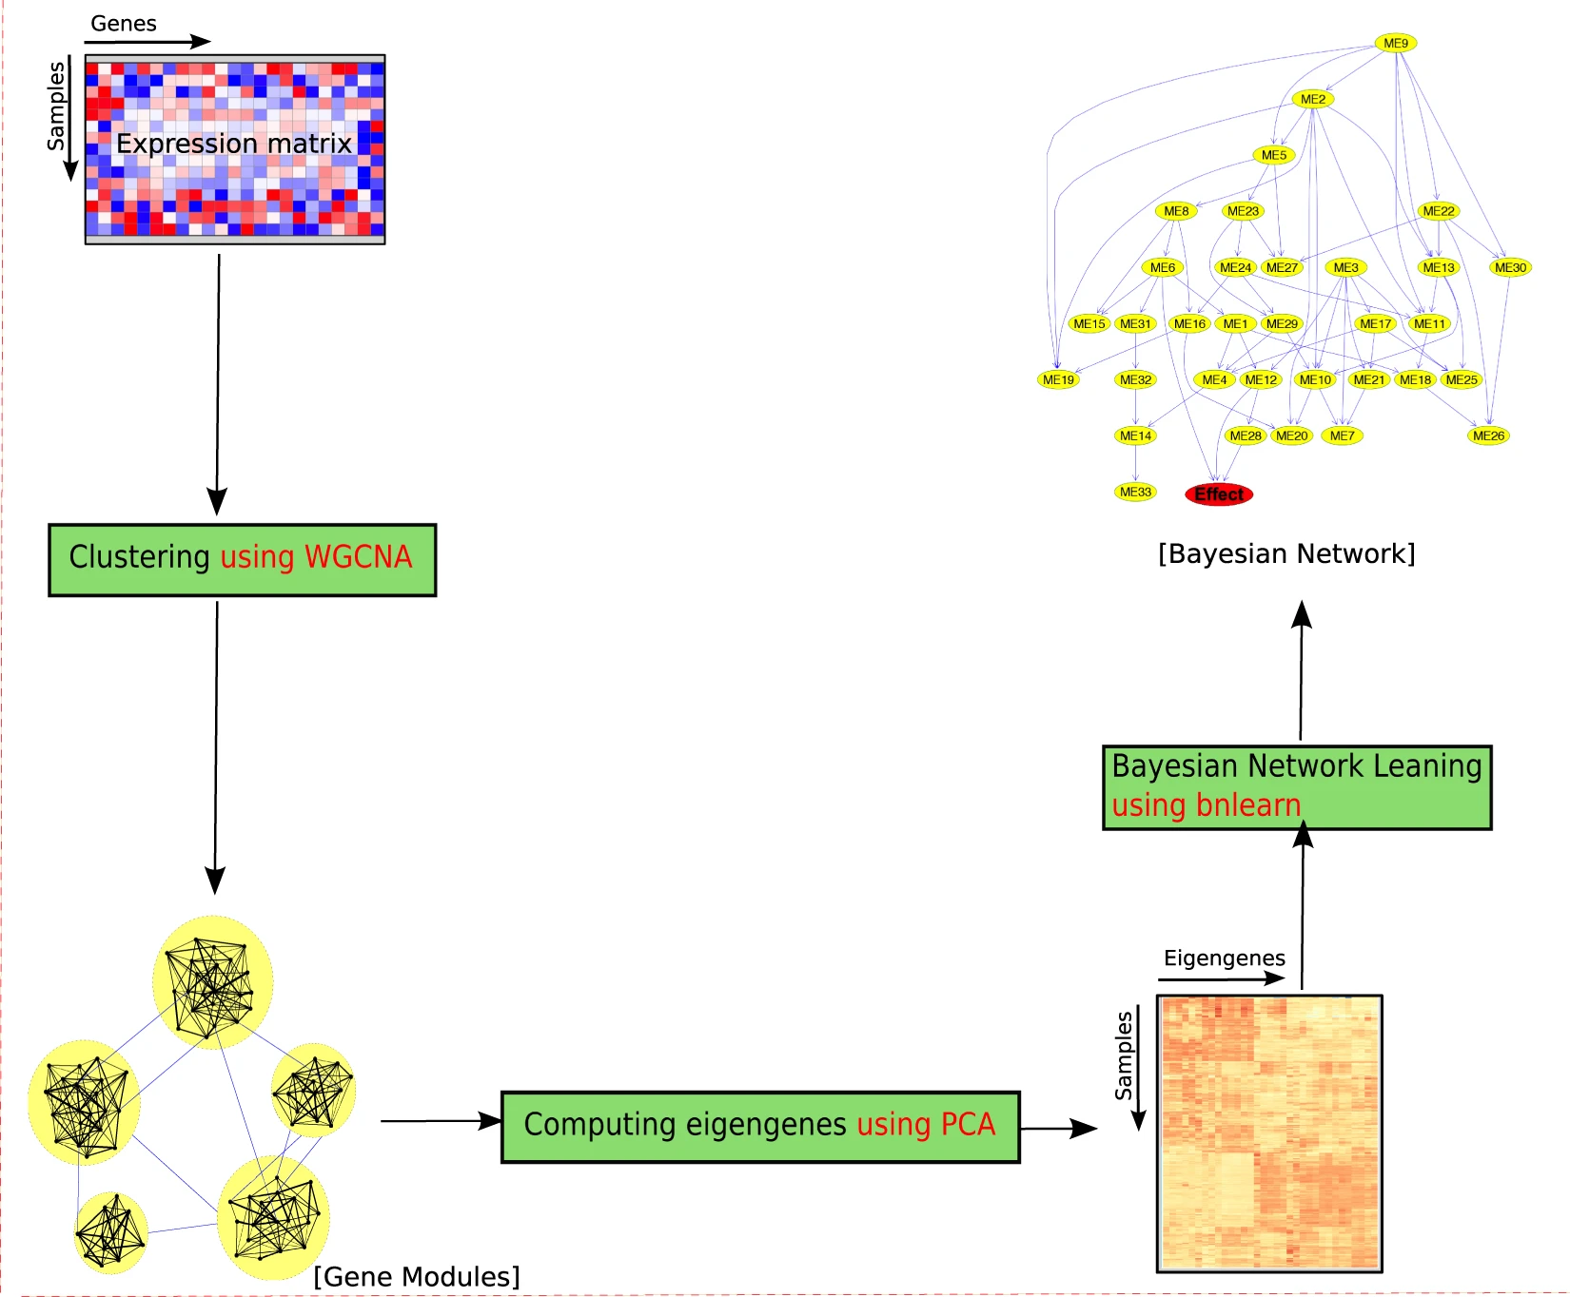
Bayesian Networks for Omics Integration
Agrahari R. et al., Sci Rep. 2018 3;8(1):6951

Slide 27
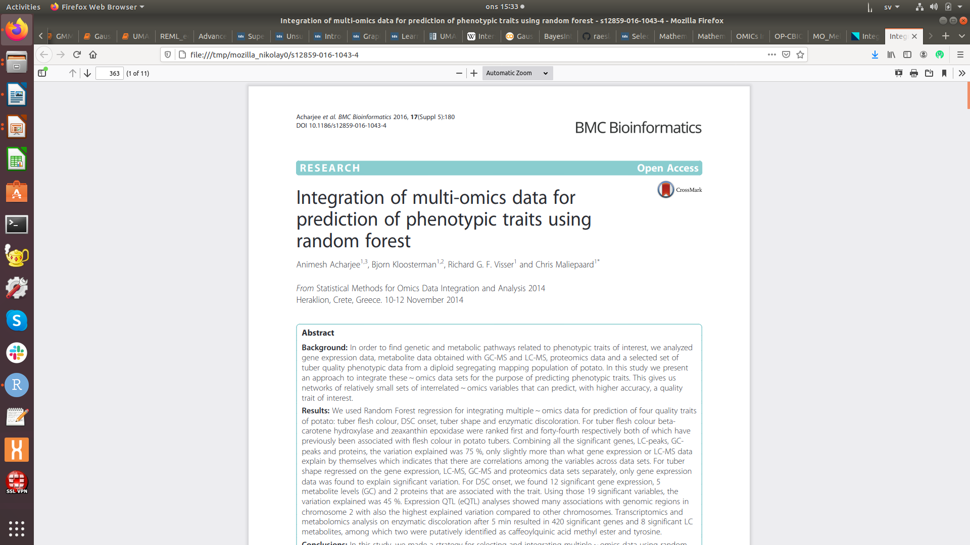
Random Forest for Omics Integration

Slide 28




National Bioinformatics Infrastructure Sweden (NBIS)

